Slide 1
Experiment Tutorial
You are about to participate in an experiment that should last for about an hour. Before continuing, please read and fill out the consent form. The experimenter will give you a number, such as “0001” to use instead of your name. They will be nearby to help in any way, but the experimental protocol prevents them from answering some questions. Please do not select the “refresh” button. This tutorial will explain how the experiment works. It will refer to keys you will need to press to progress through the experiment, but because these instructions are in a separate program, just press the arrow keys to progress through this tutorial.

Slide 2
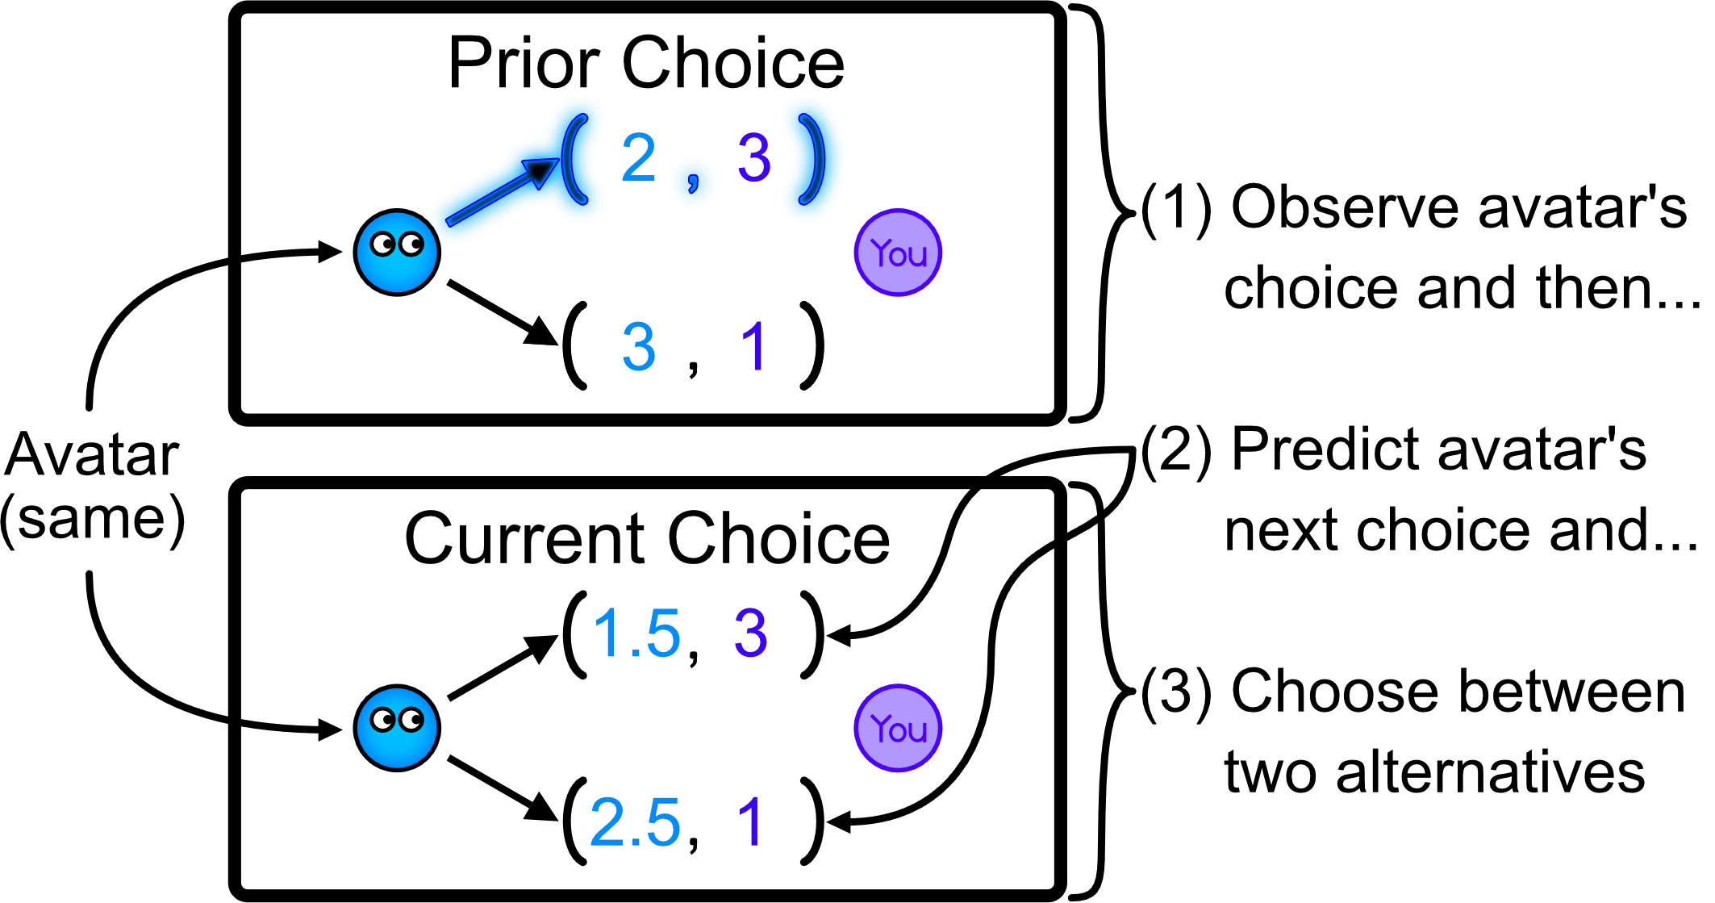
There are two segments of the experiment. In the first segment you will encounter a randomly ordered sequence of 216 unique avatars. Act towards each avatar as if you are encountering a real person for the first time where both of you expect to encounter each other many times in the future. During each encounter you will (1) observe them make a choice, (2) predict their next choice and then (3) choose between two alternatives.

Slide 3
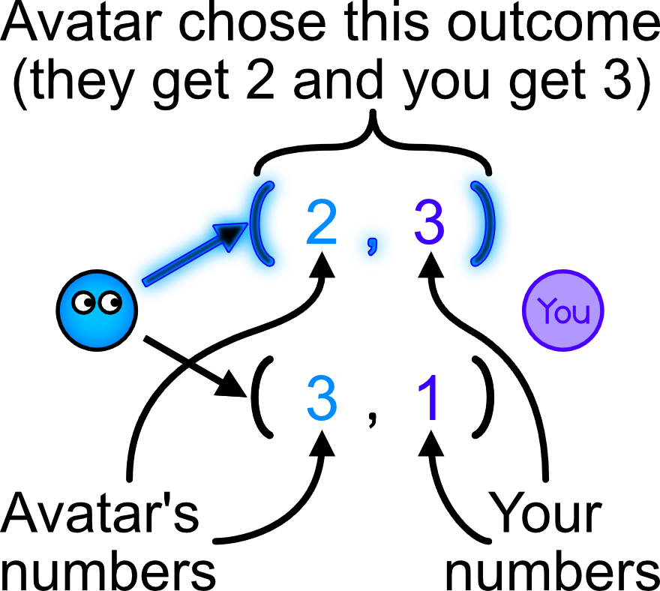
These choices determine a number for you and for the avatar. The two alternatives are the numbers within parentheses that the arrows point to. The avatar’s choice is highlighted in blue. Your numbers are purple, and the avatar’s numbers are black or the color of the avatar. Everyone prefers a higher number.

Slide 4
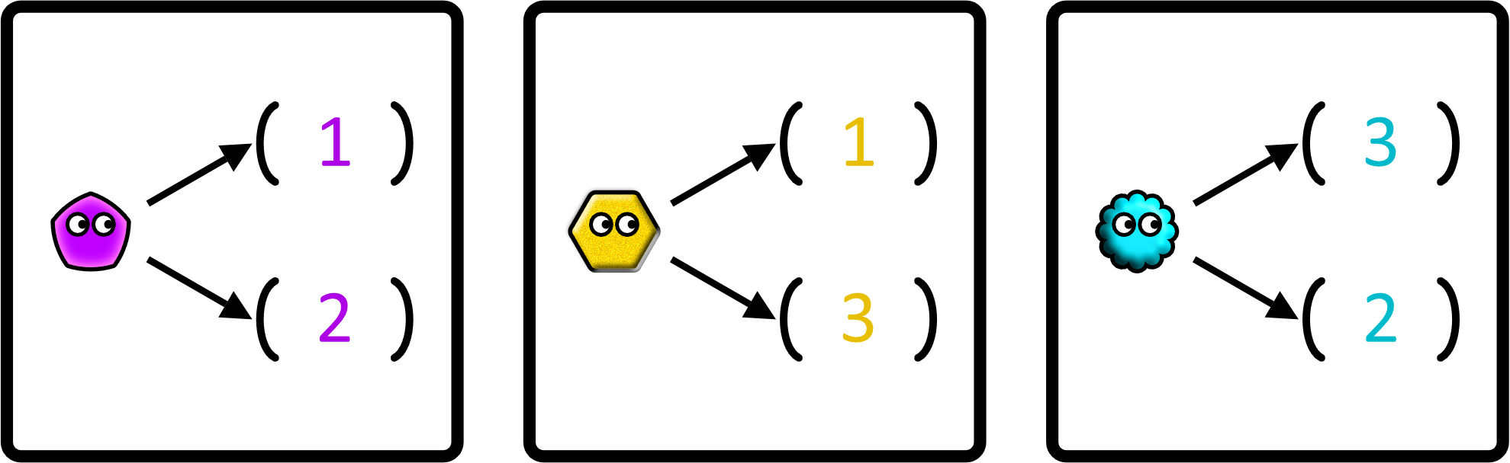
Notice how the avatar will feel depending on the number in the outcome compared to the alternative.

Slide 5
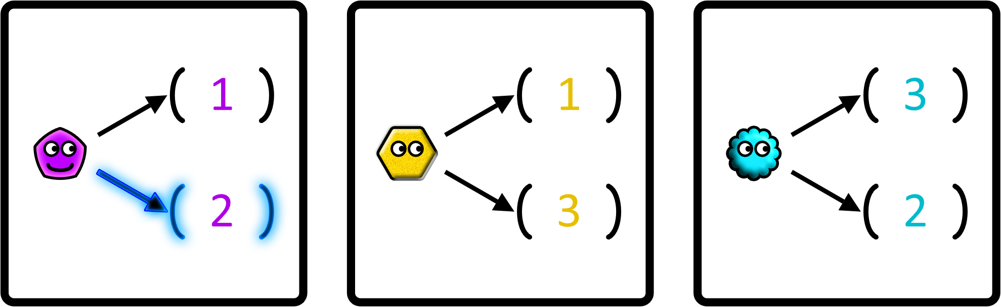
Notice how the avatar will feel depending on the number in the outcome compared to the alternative.

Slide 6
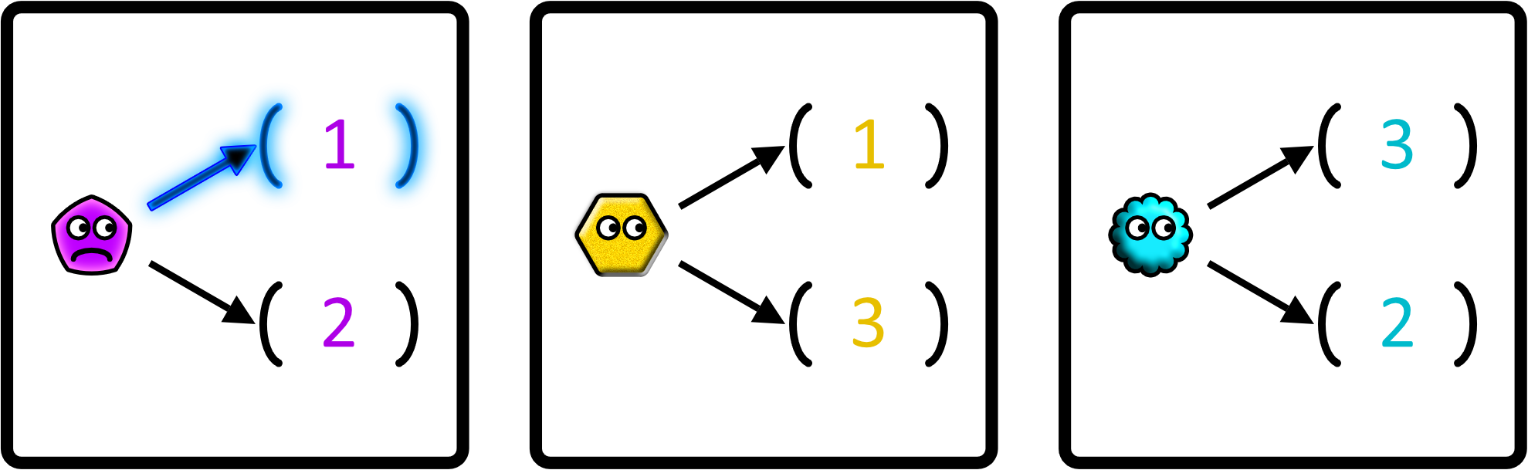
Notice how the avatar will feel depending on the number in the outcome compared to the alternative.

Slide 7
Notice how the avatar will feel depending on the number in the outcome compared to the alternative.

Slide 8
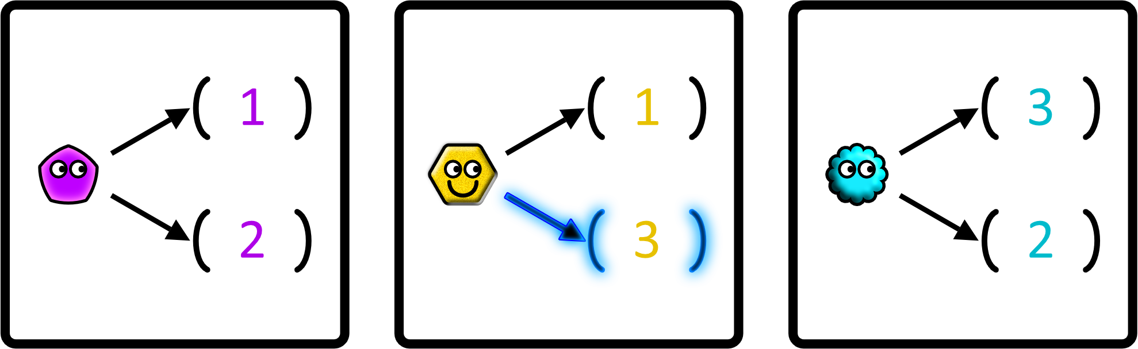
Notice how the avatar will feel depending on the number in the outcome compared to the alternative.

Slide 9
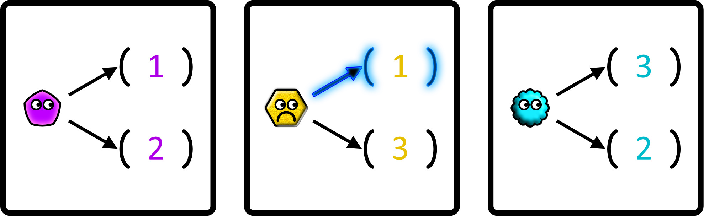
Notice how the avatar will feel depending on the number in the outcome compared to the alternative.

Slide 10
Notice how the avatar will feel depending on the number in the outcome compared to the alternative.

Slide 11
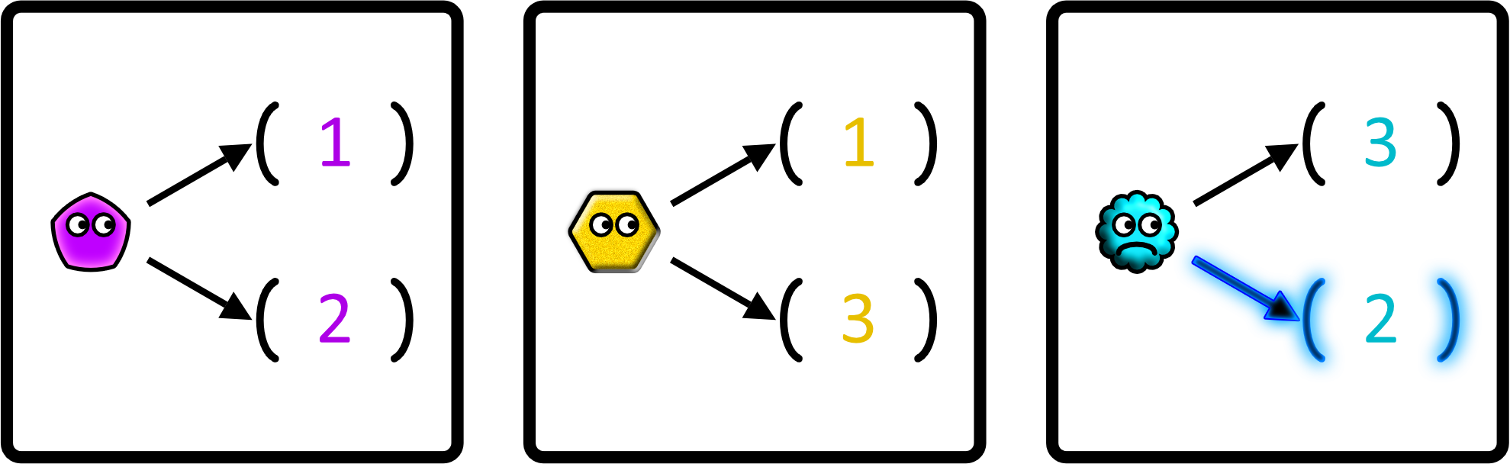
Notice how the avatar will feel depending on the number in the outcome compared to the alternative.

Slide 12
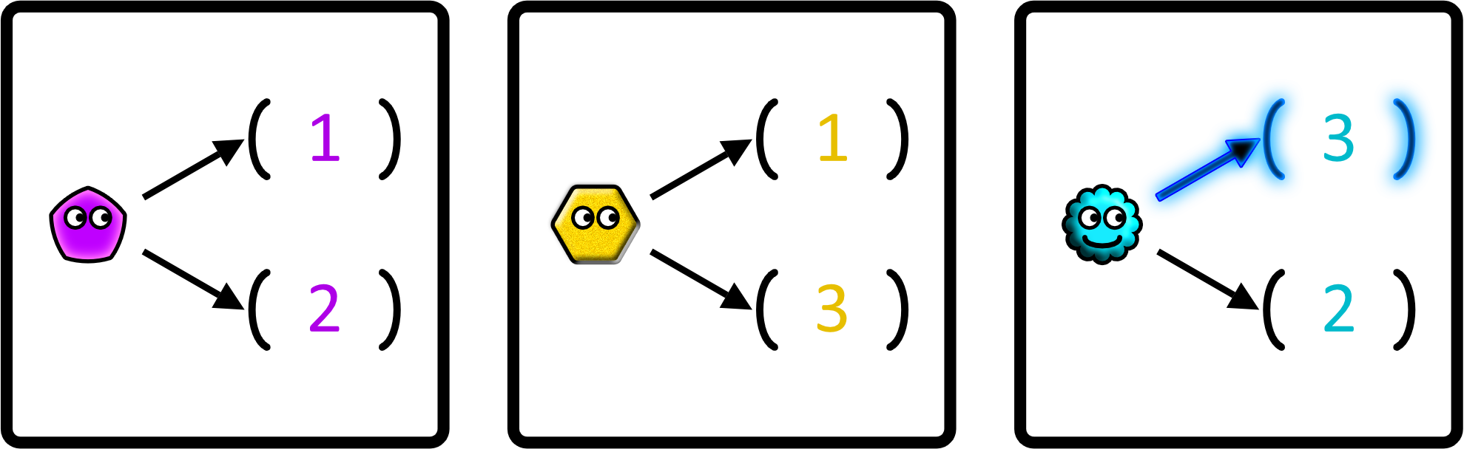
Notice how the avatar will feel depending on the number in the outcome compared to the alternative.

Slide 13
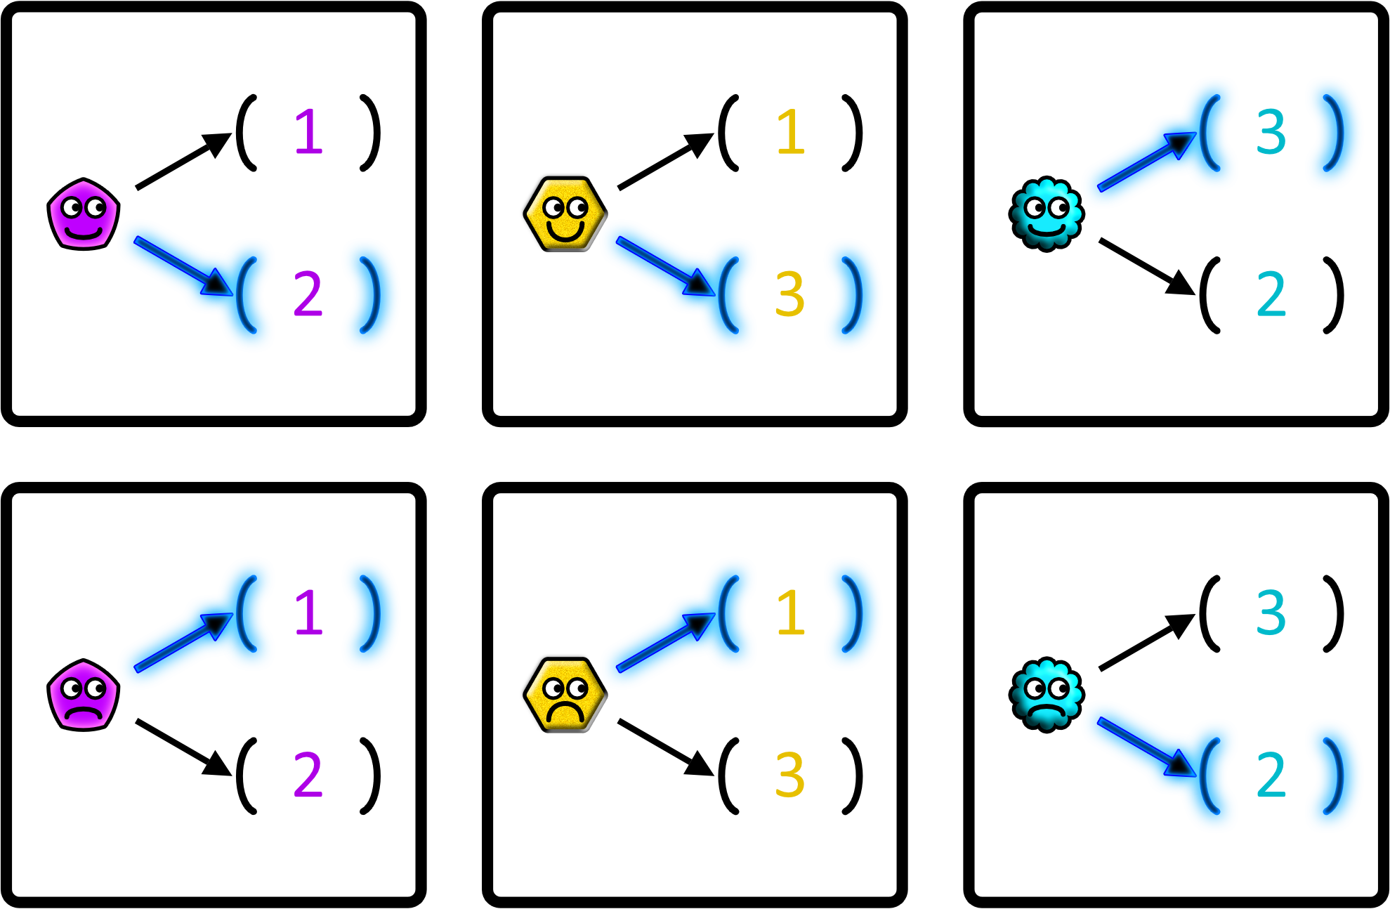

Slide 14
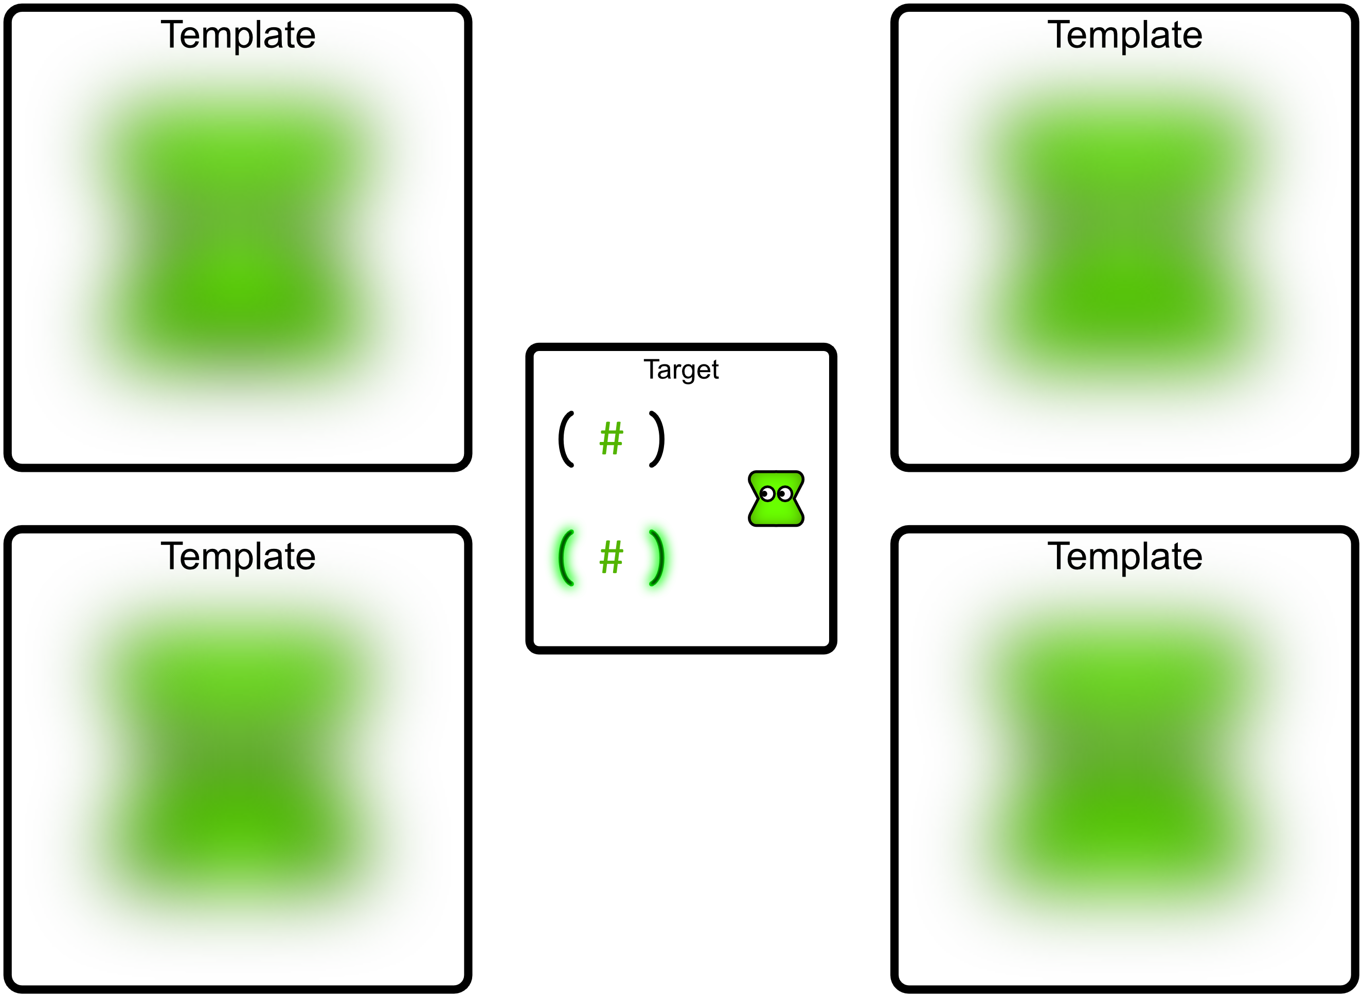
You will now be asked to predict which template best matches how the avatar will feel as a result of the outcome in the target square. The following represent situations where the avatar passively receives a number without choosing.

Slide 15
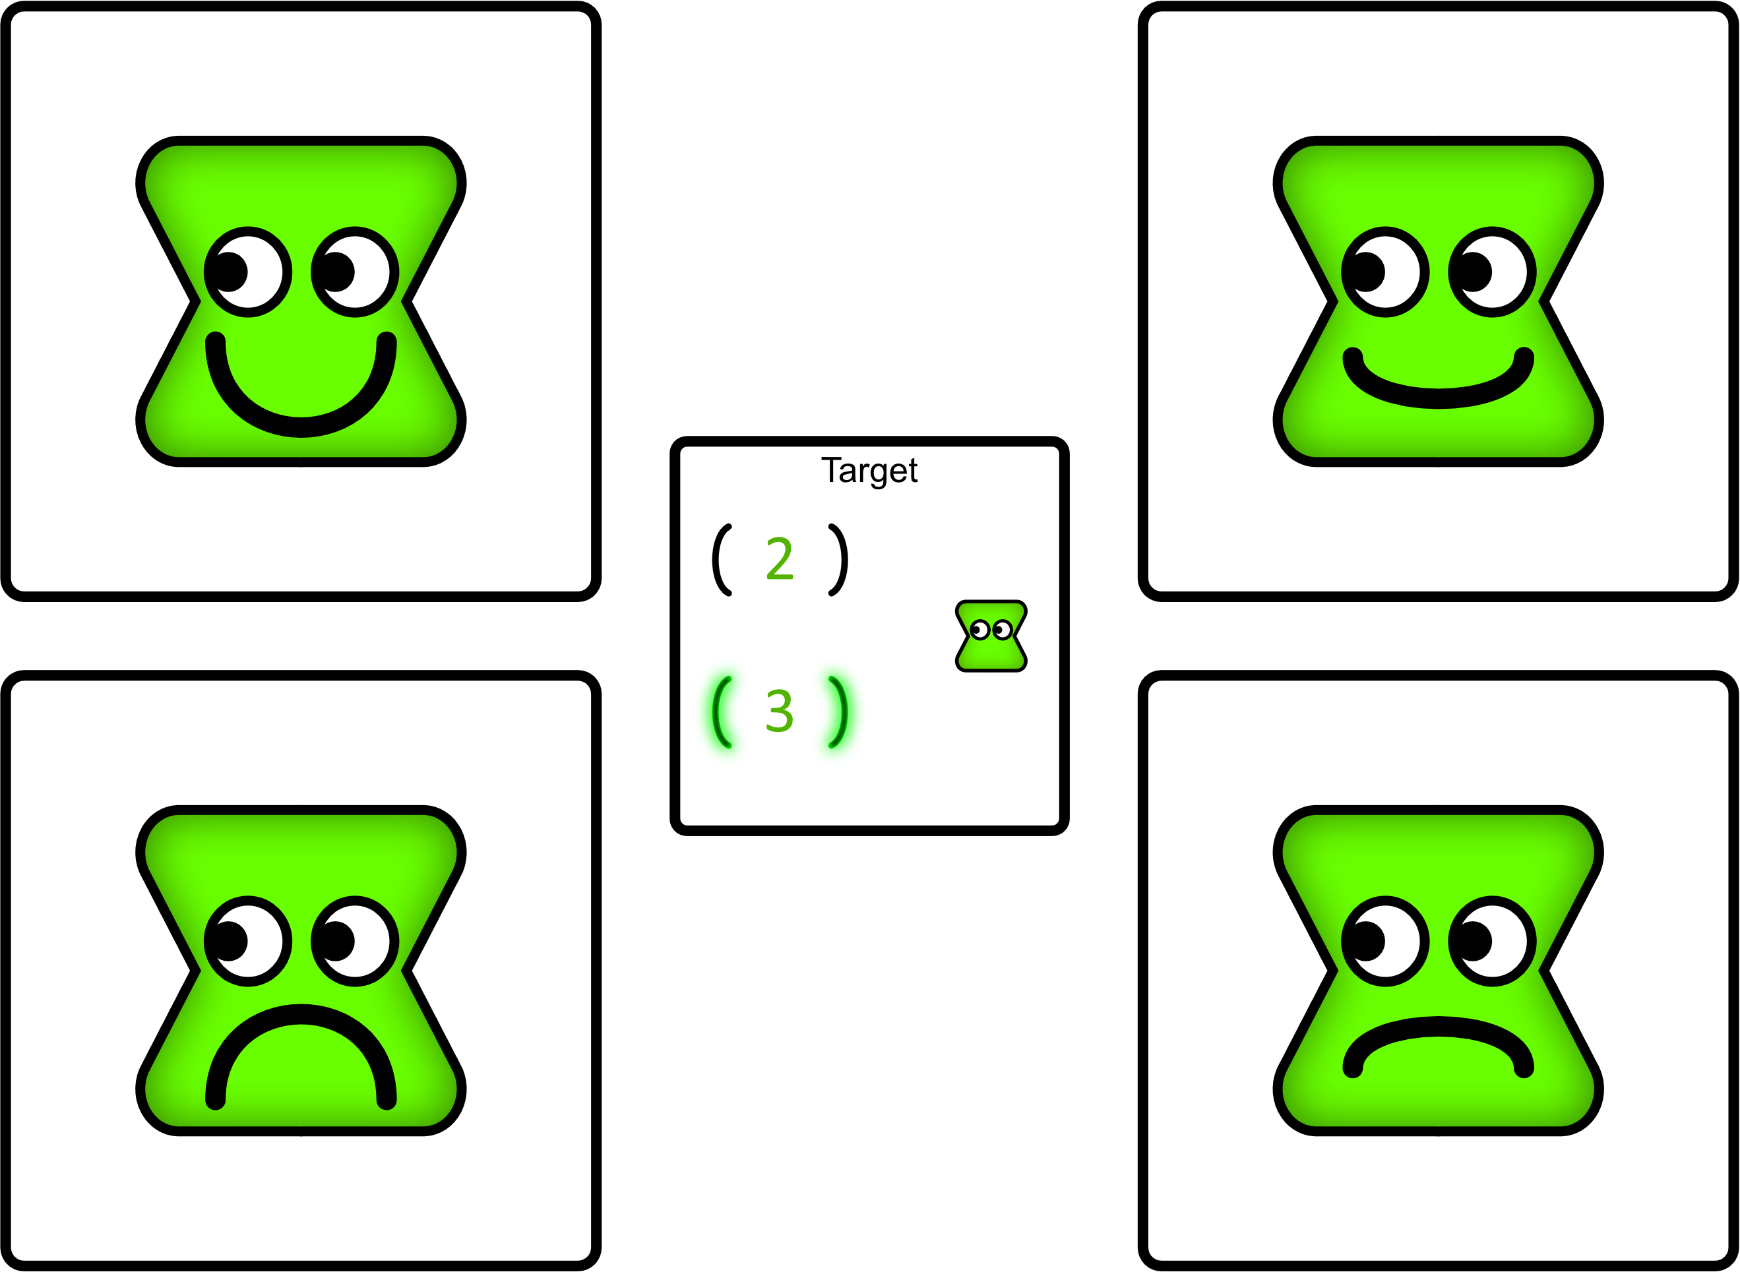
Which template best matches how the avatar will feel as a result of the outcome in the target square?

Slide 16
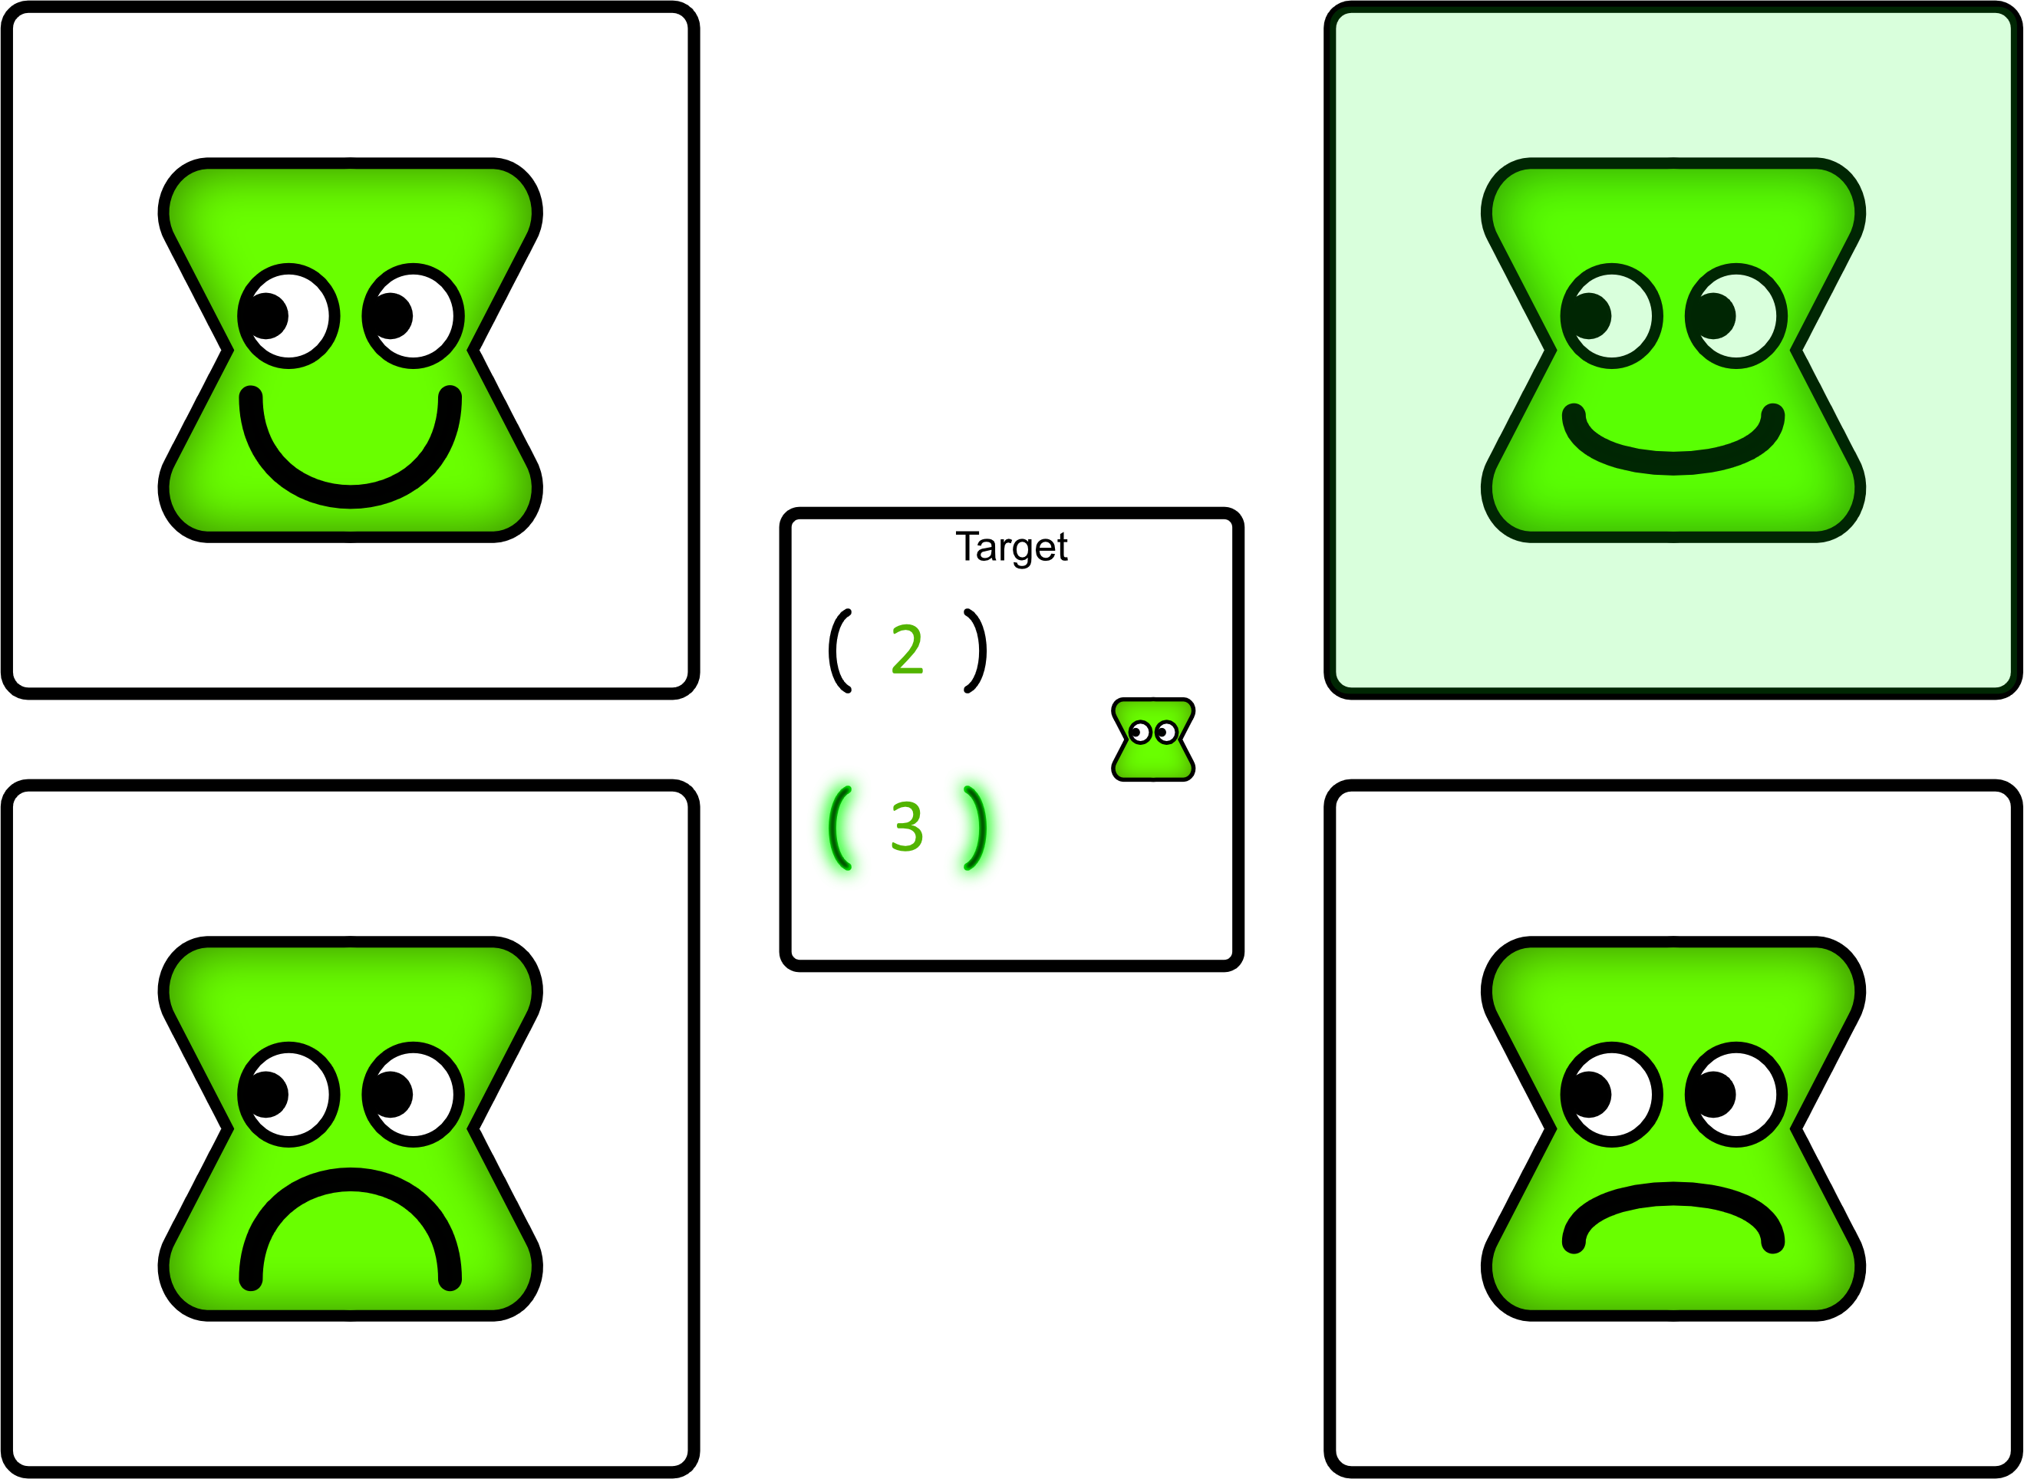
Which template best matches how the avatar will feel as a result of the outcome in the target square?

Slide 17
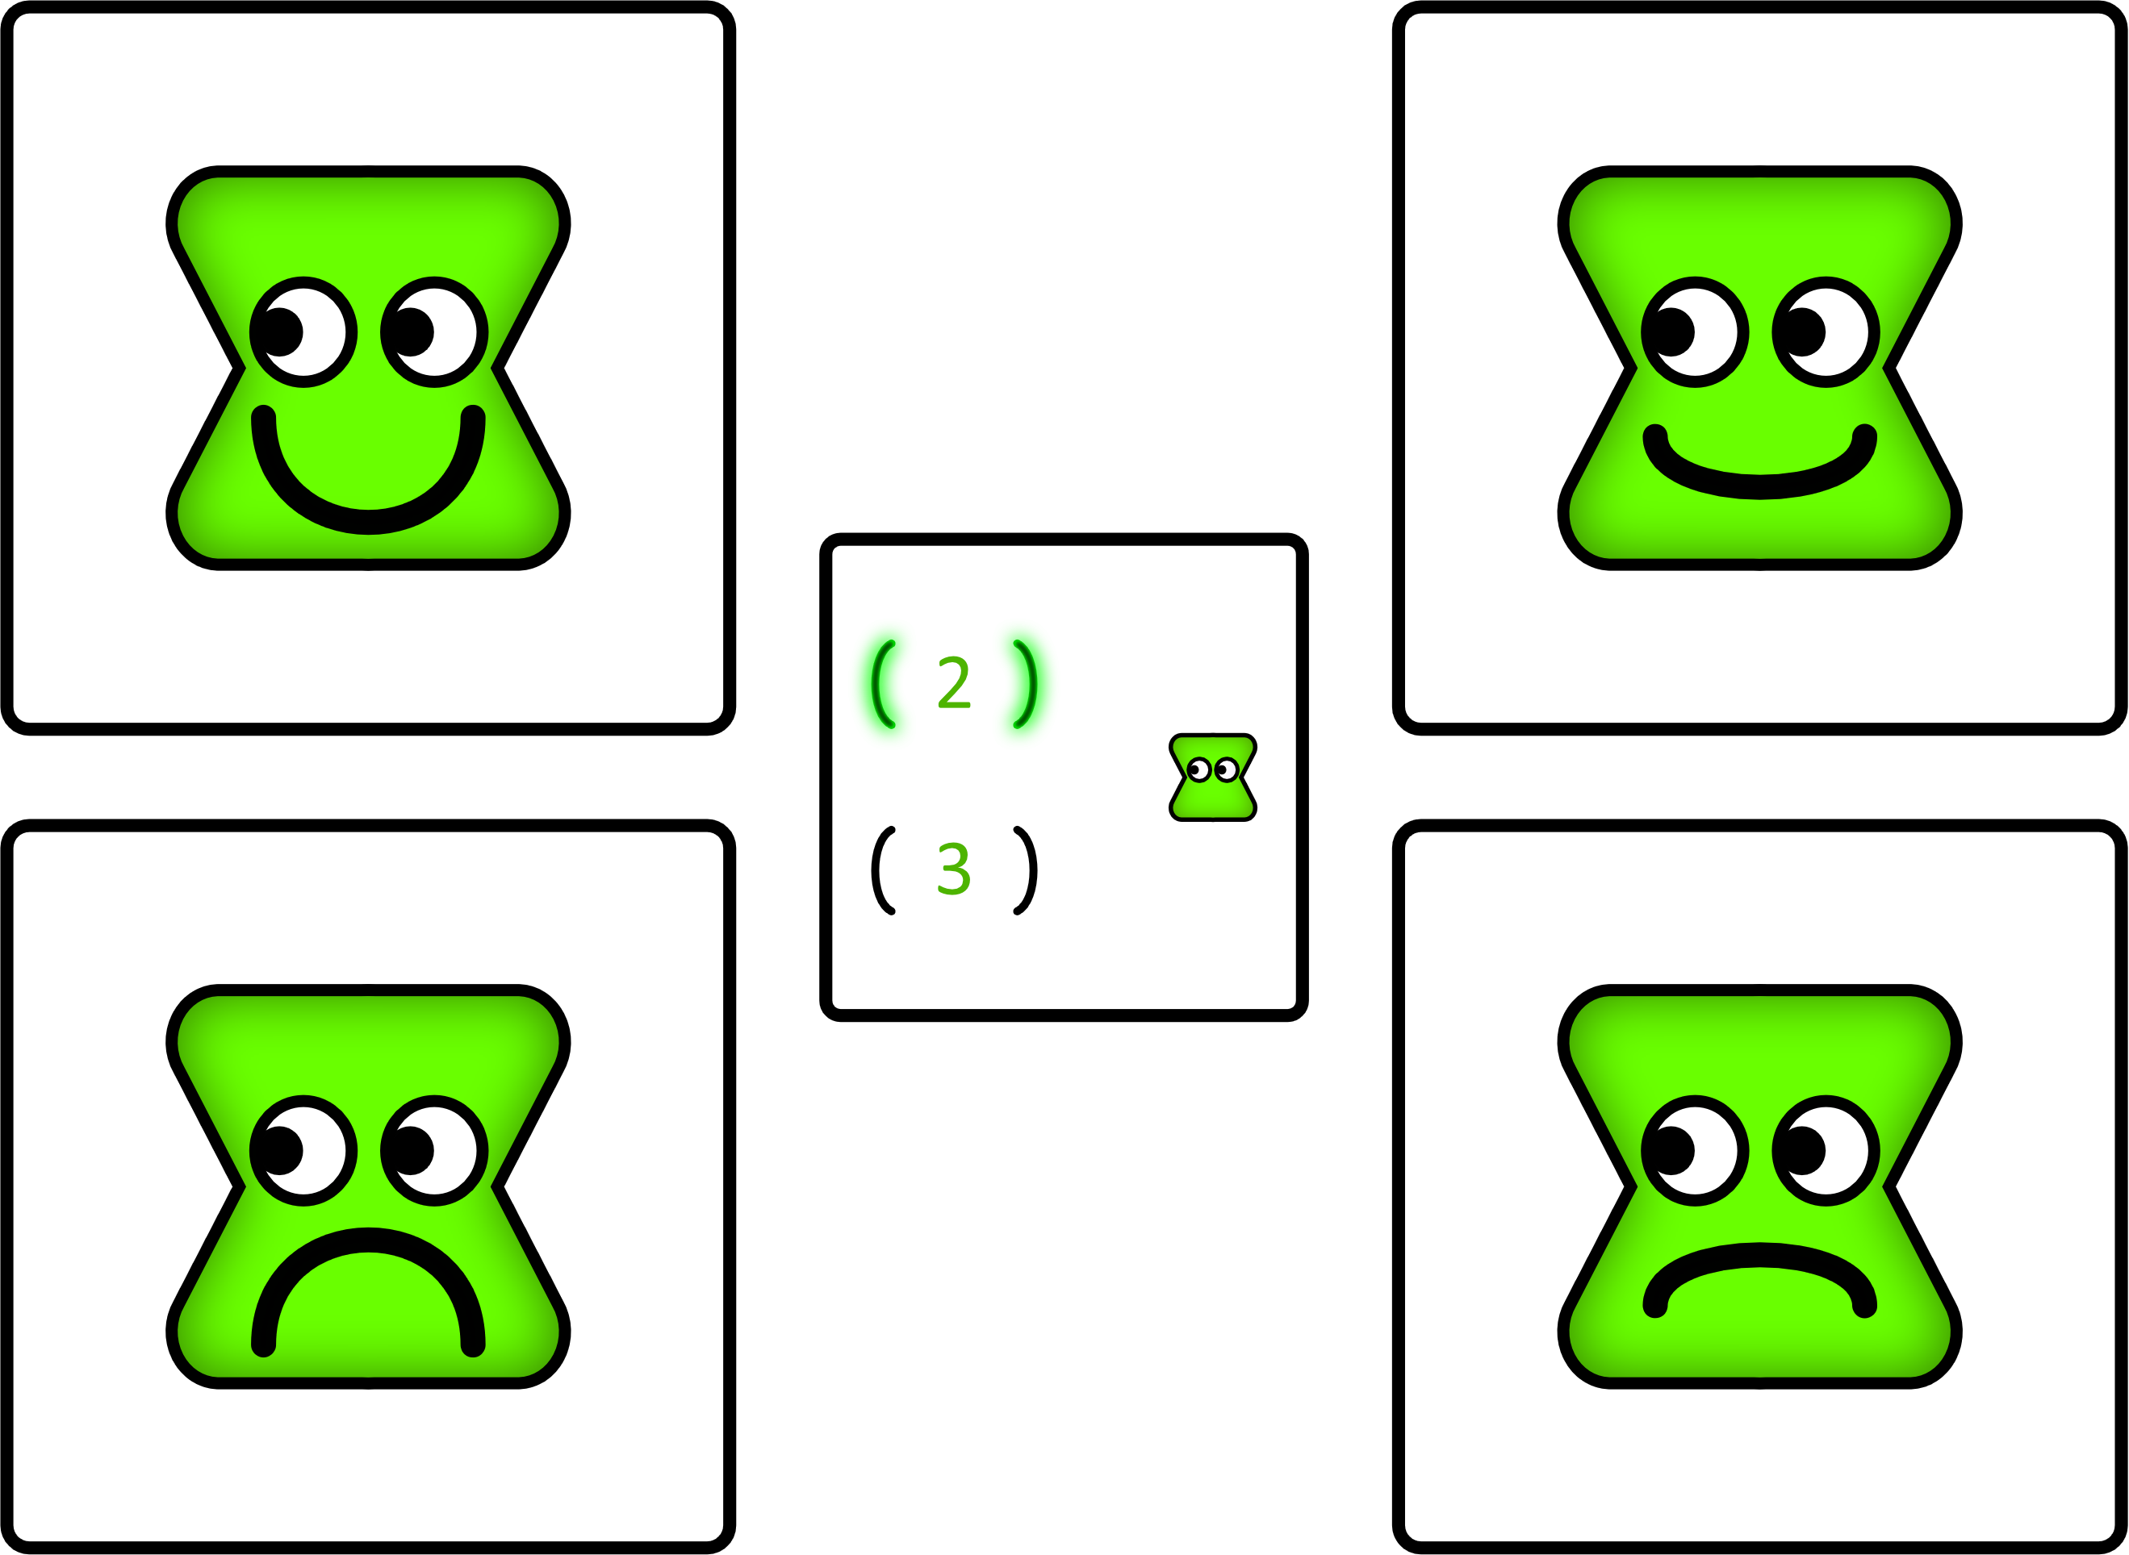
Which template best matches how the avatar will feel as a result of the outcome in the target square?

Slide 18
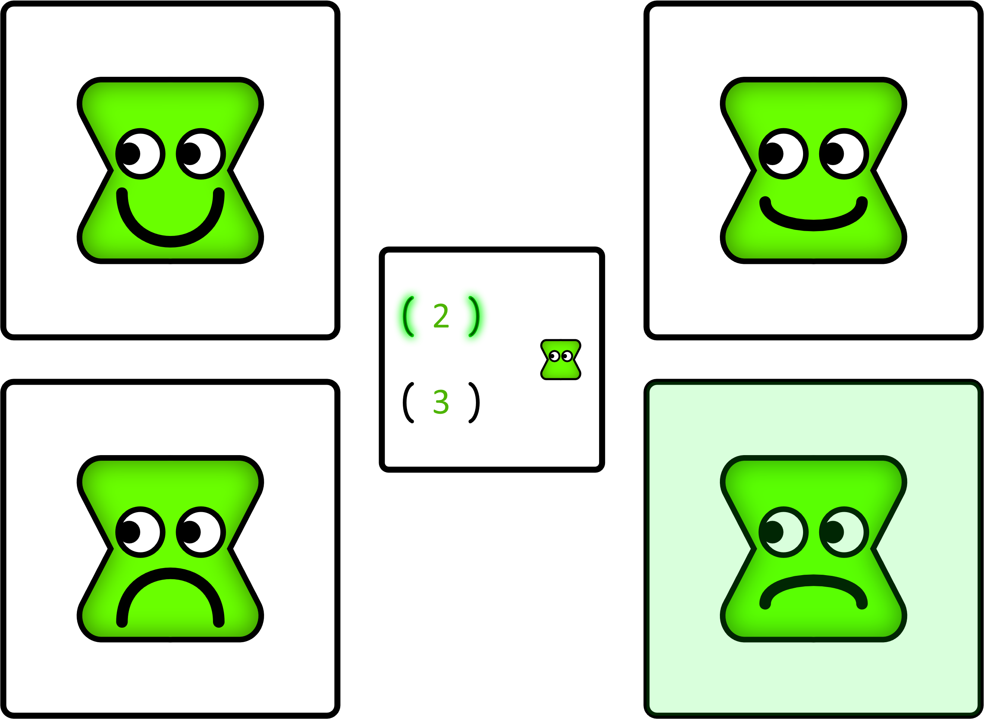
Which template best matches how the avatar will feel as a result of the outcome in the target square?

Slide 19
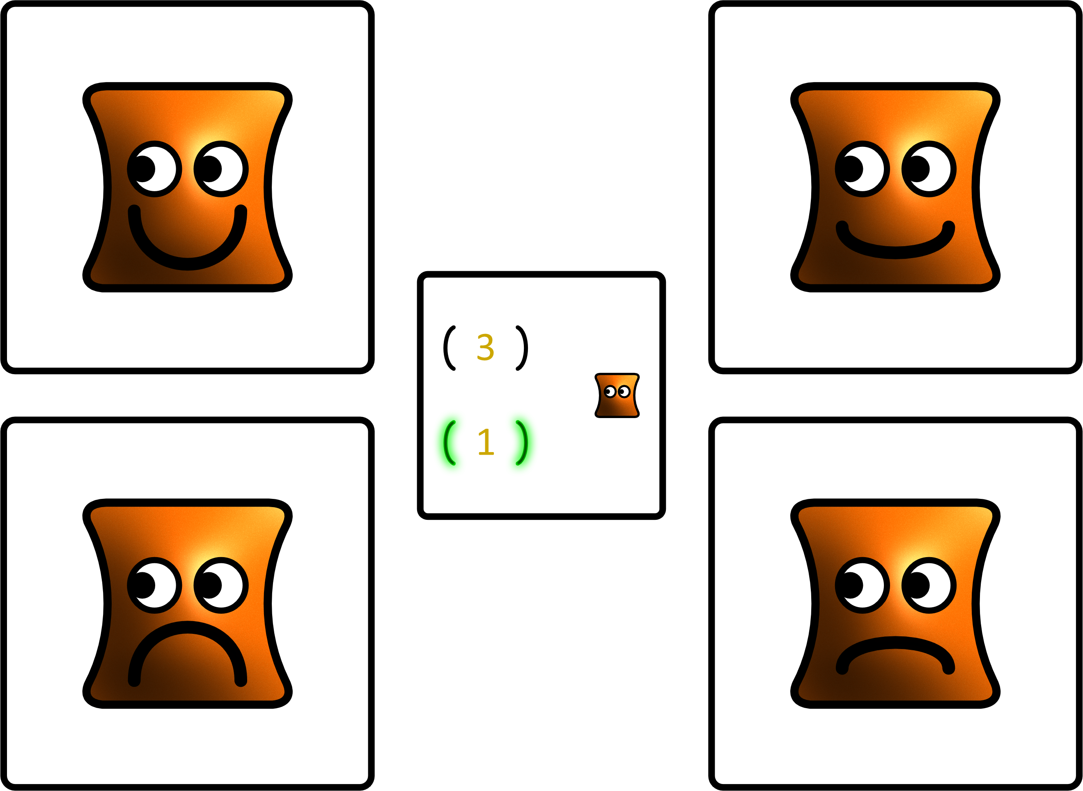
Which template best matches how the avatar will feel as a result of the outcome in the target square?

Slide 20
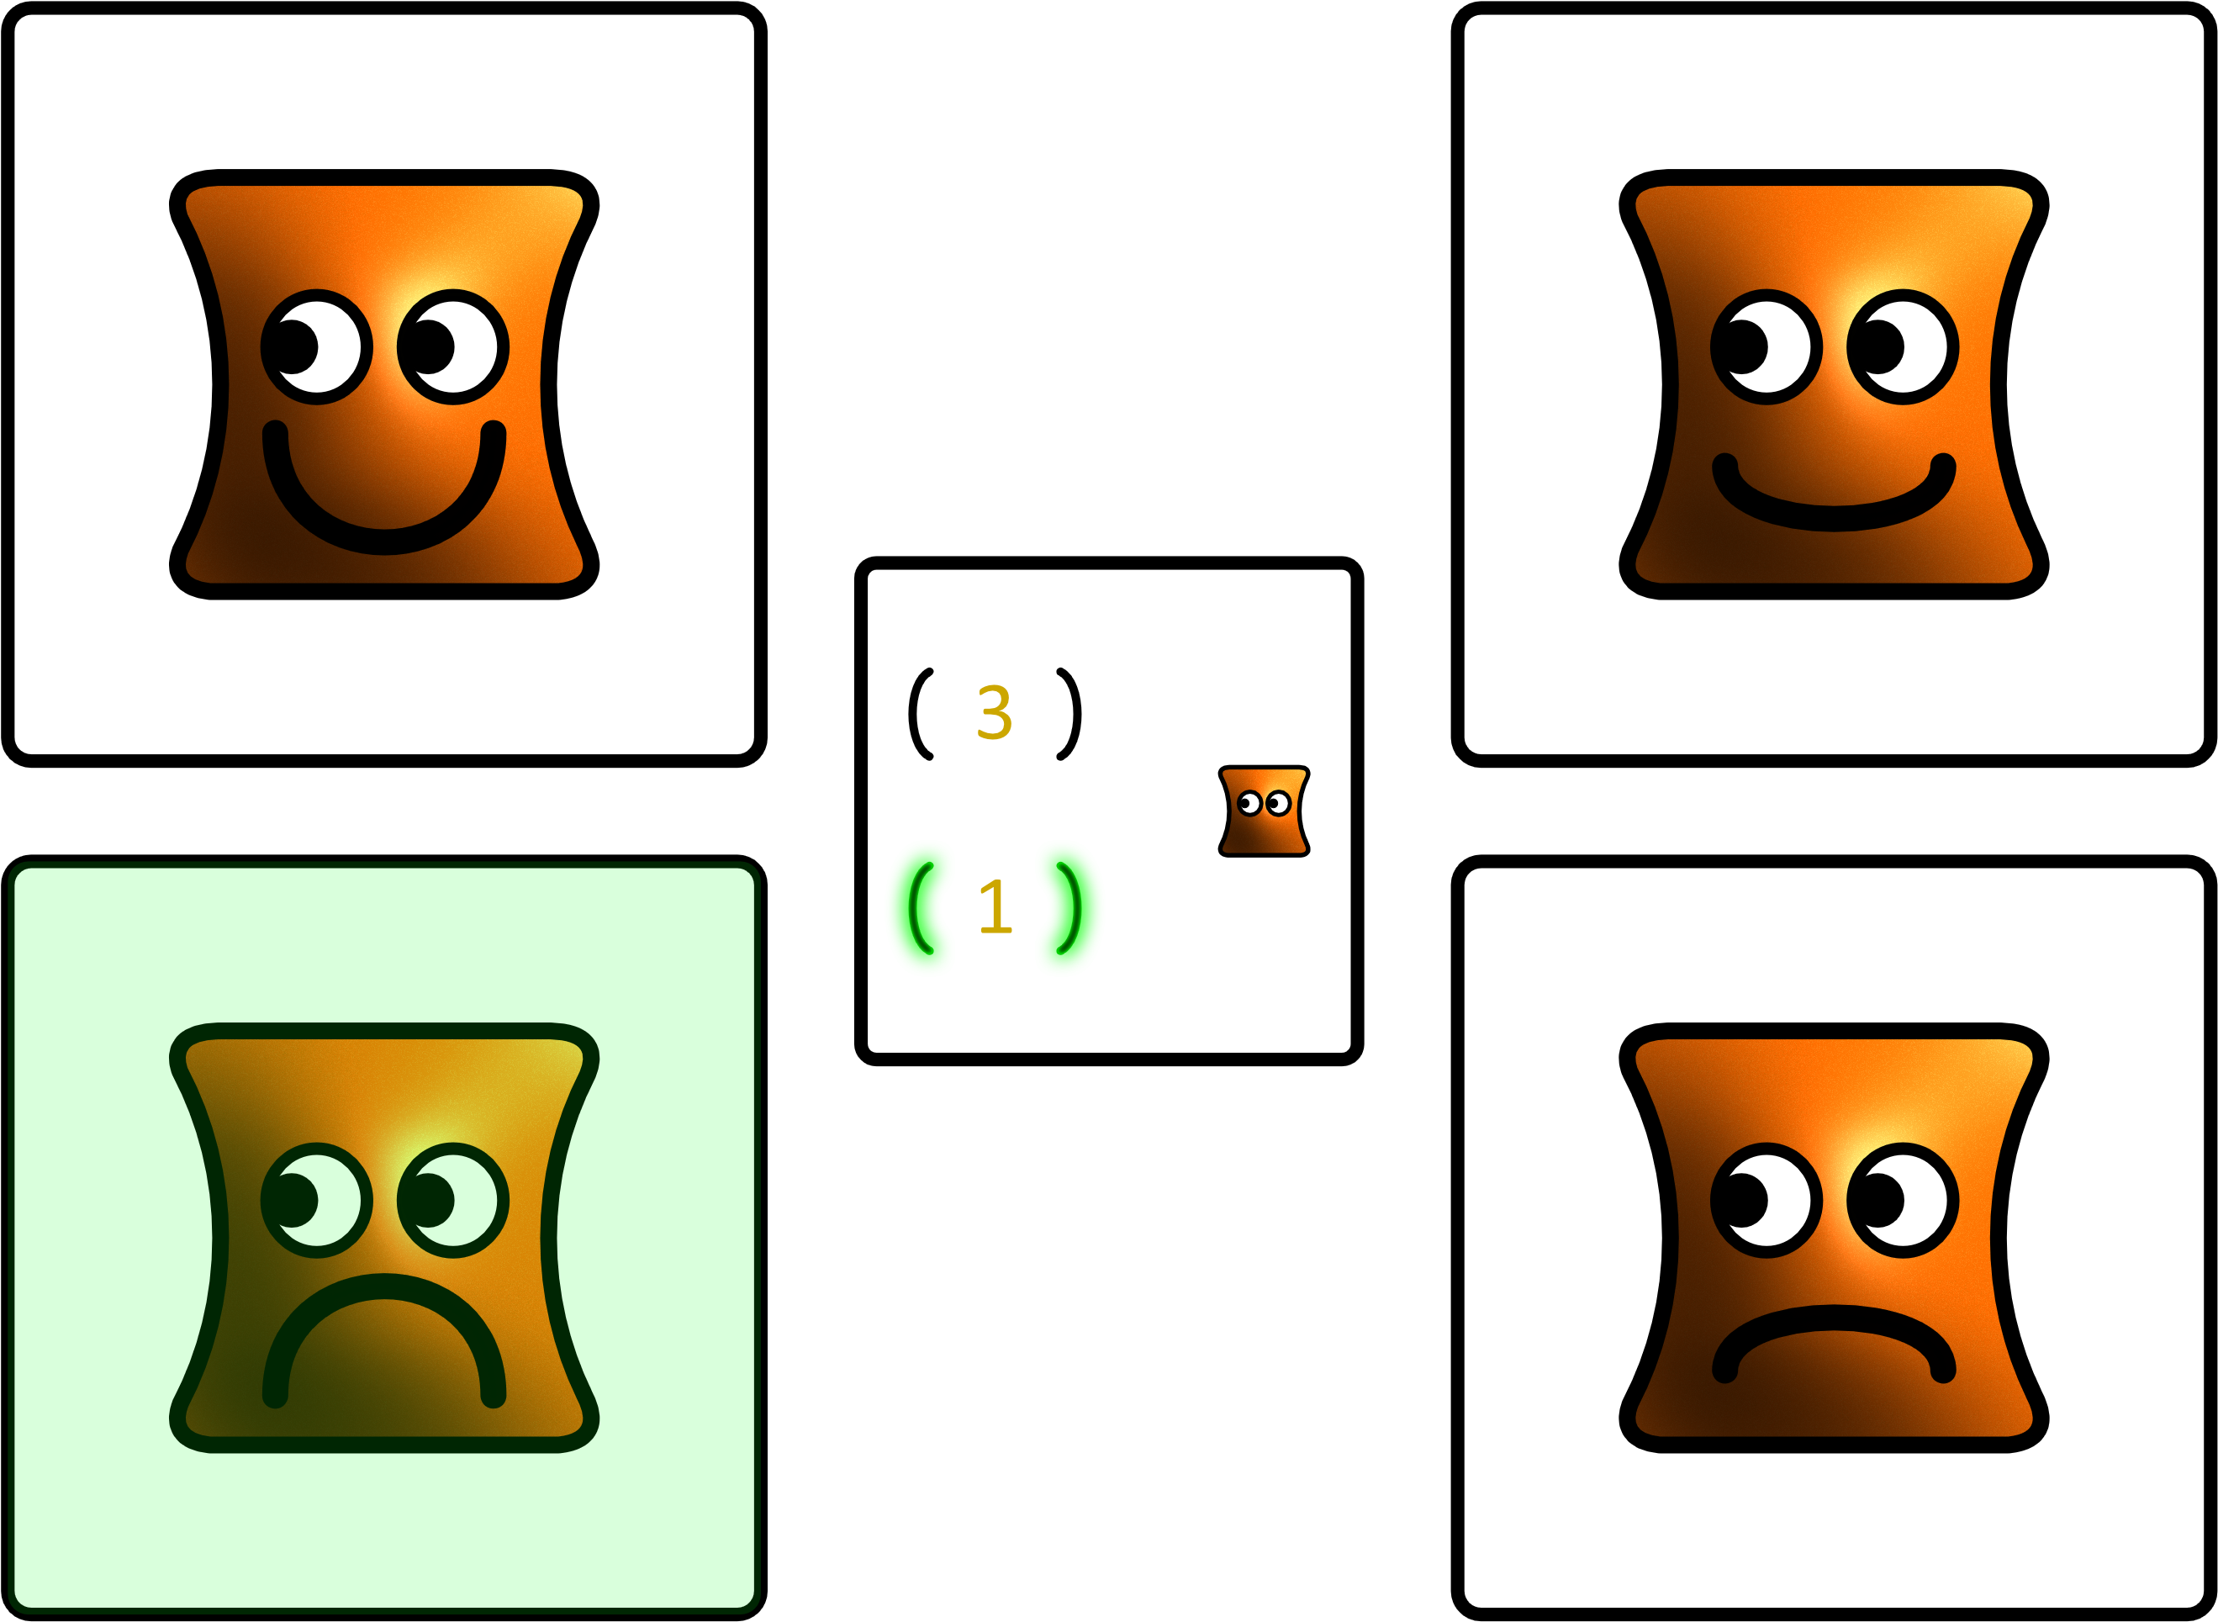
Which template best matches how the avatar will feel as a result of the outcome in the target square?

Slide 21
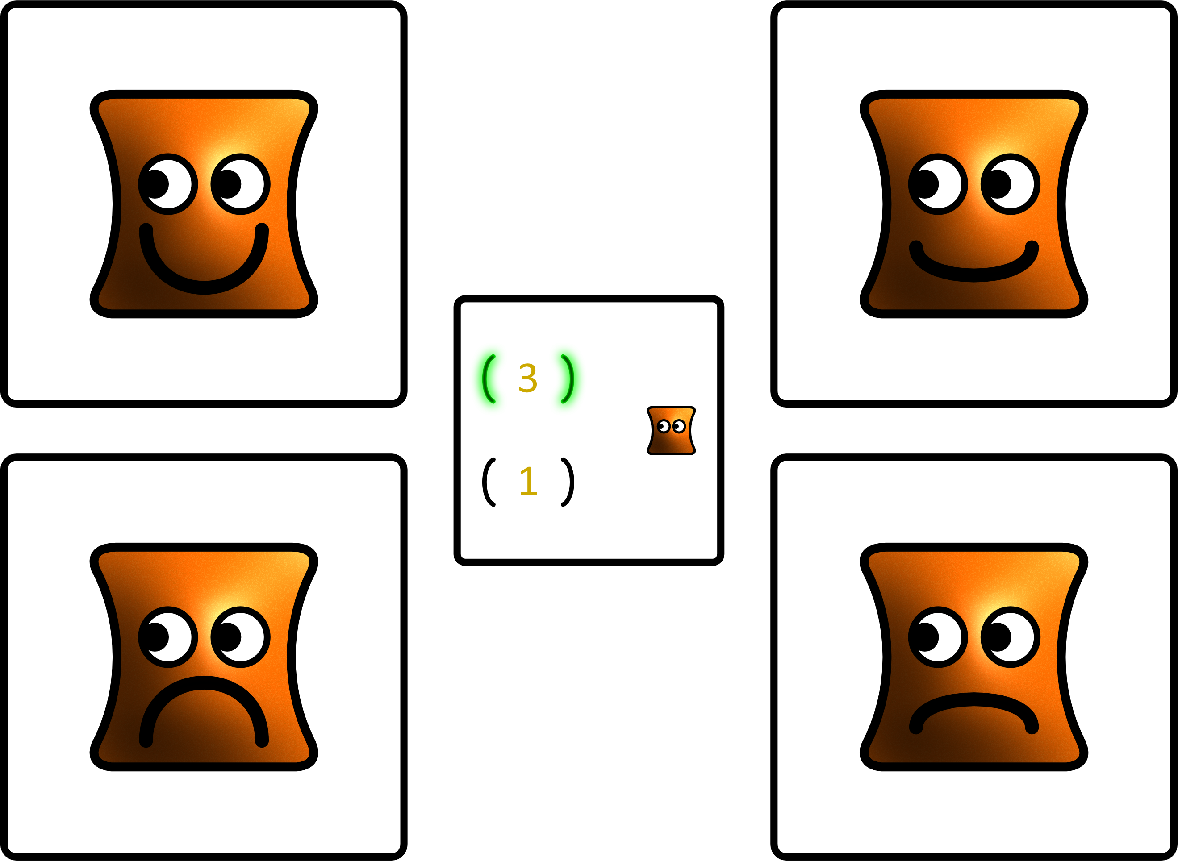
Which template best matches how the avatar will feel as a result of the outcome in the target square?

Slide 22
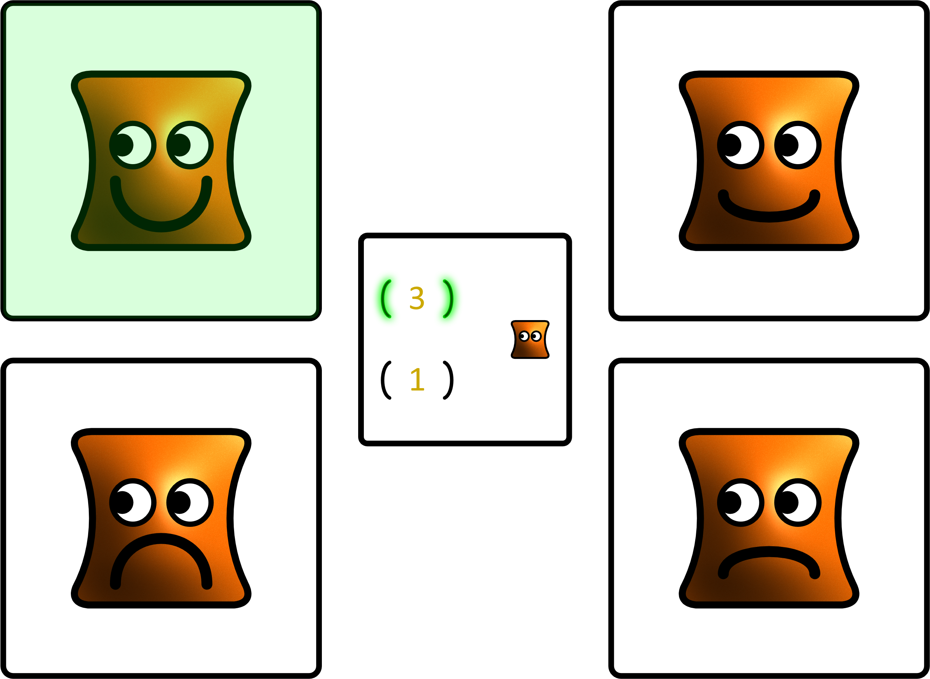
Which template best matches how the avatar will feel as a result of the outcome in the target square?

Slide 23
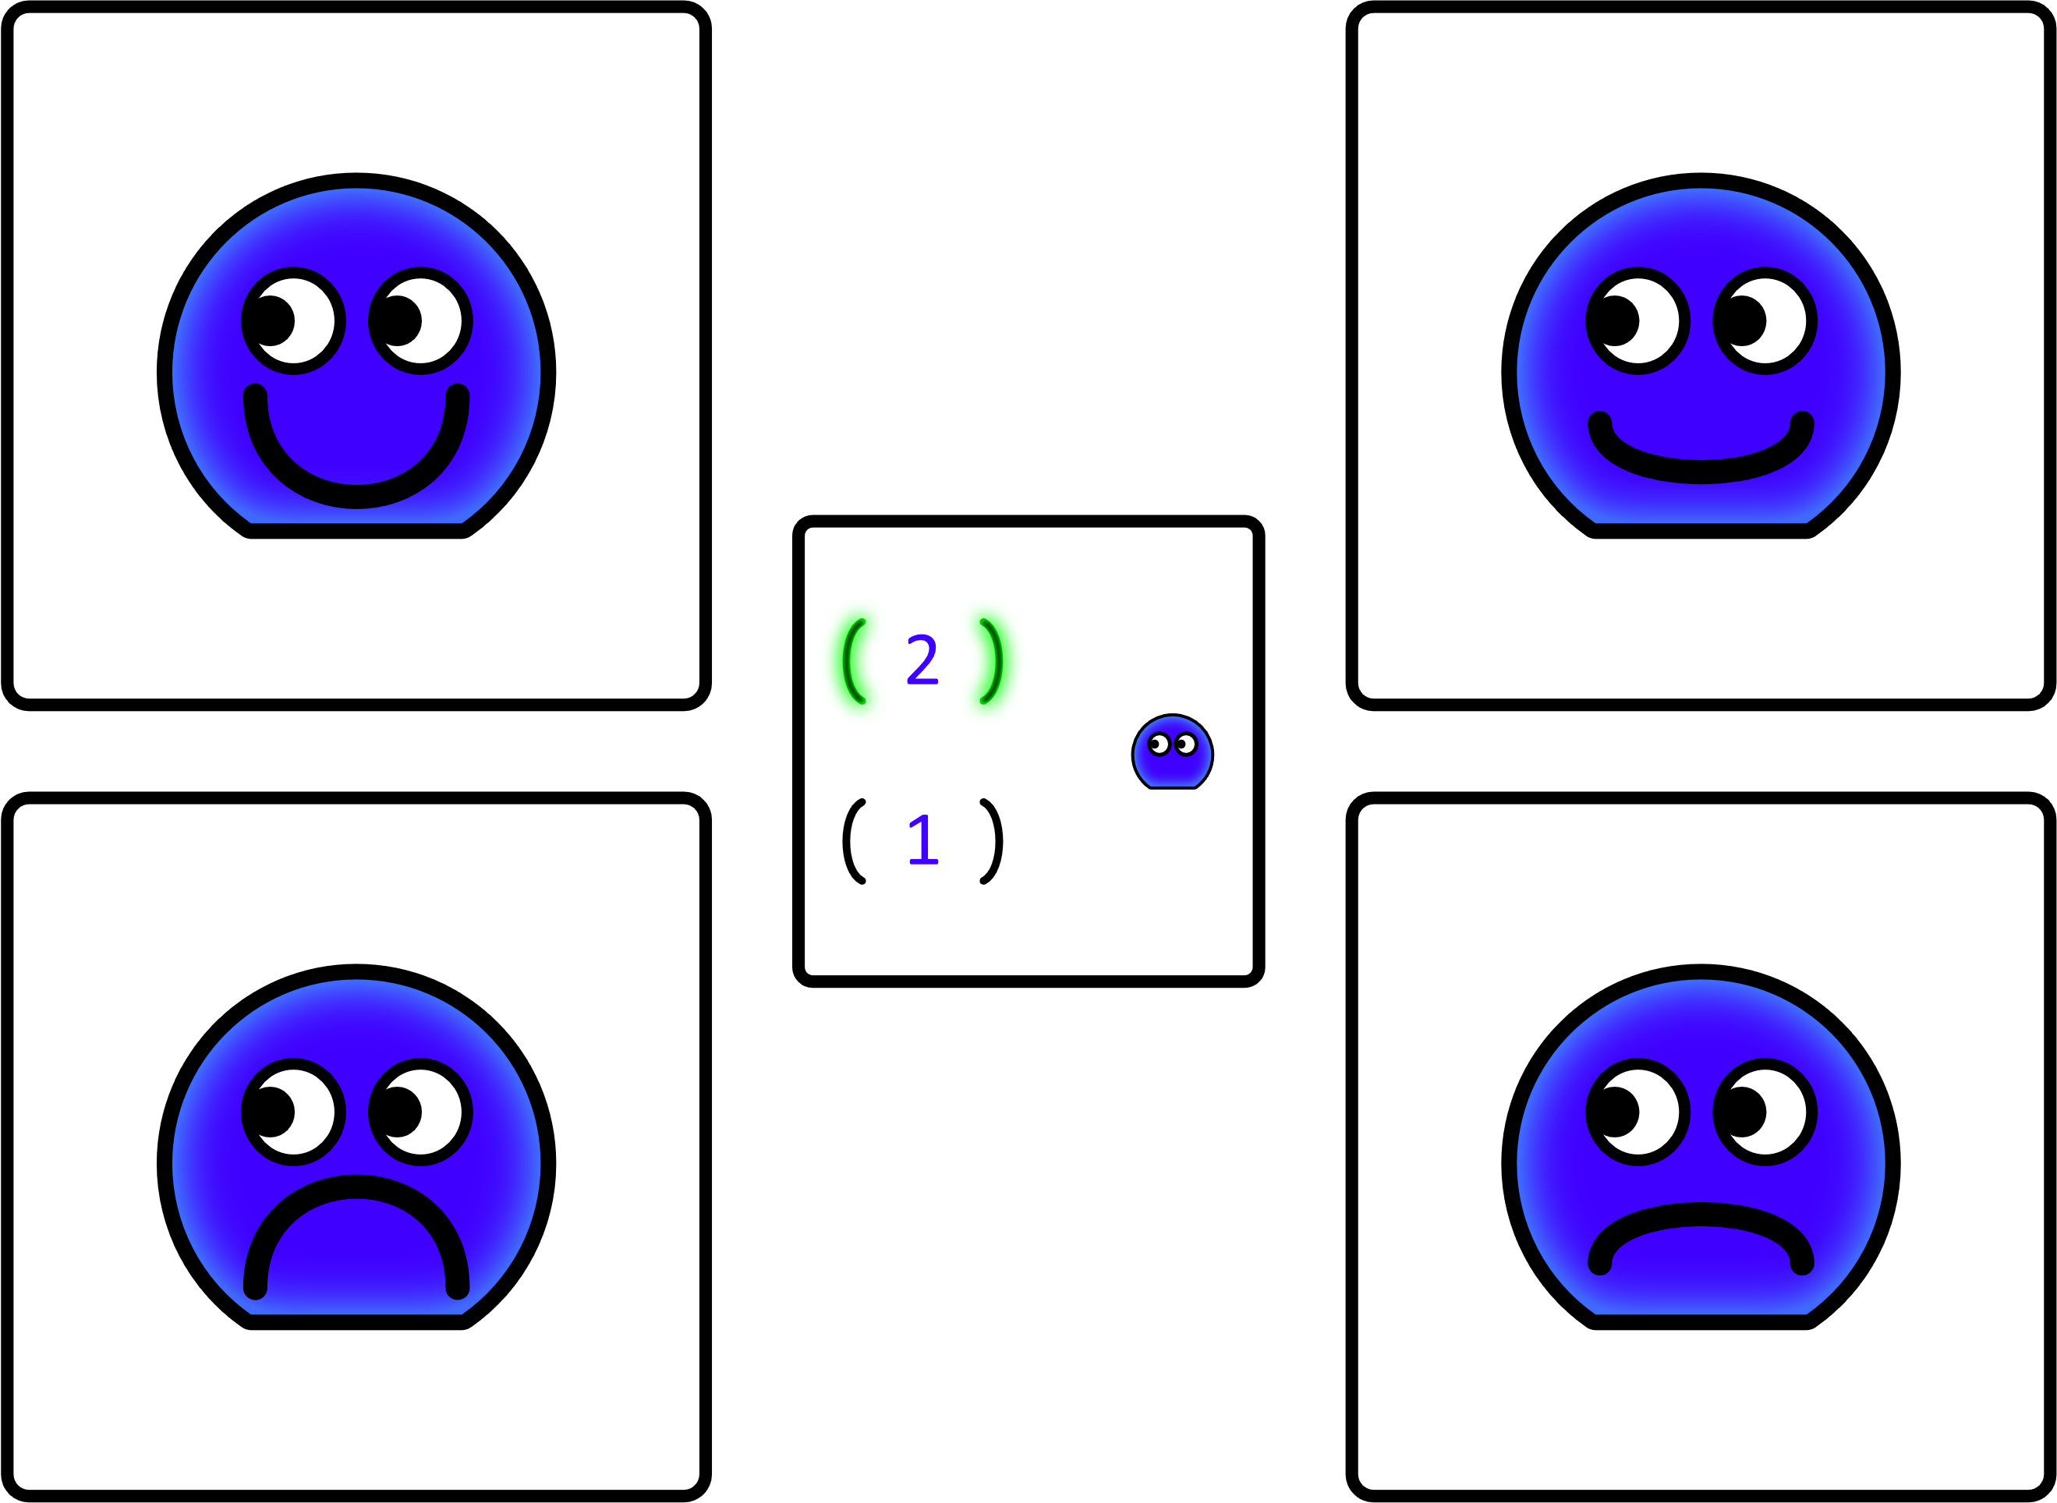
Which template best matches how the avatar will feel as a result of the outcome in the target square?

Slide 24
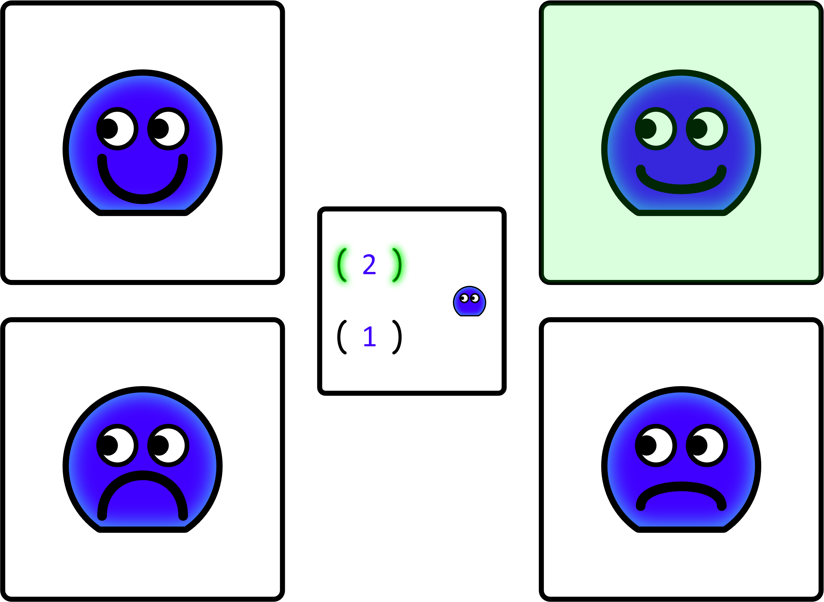
Which template best matches how the avatar will feel as a result of the outcome in the target square?

Slide 25
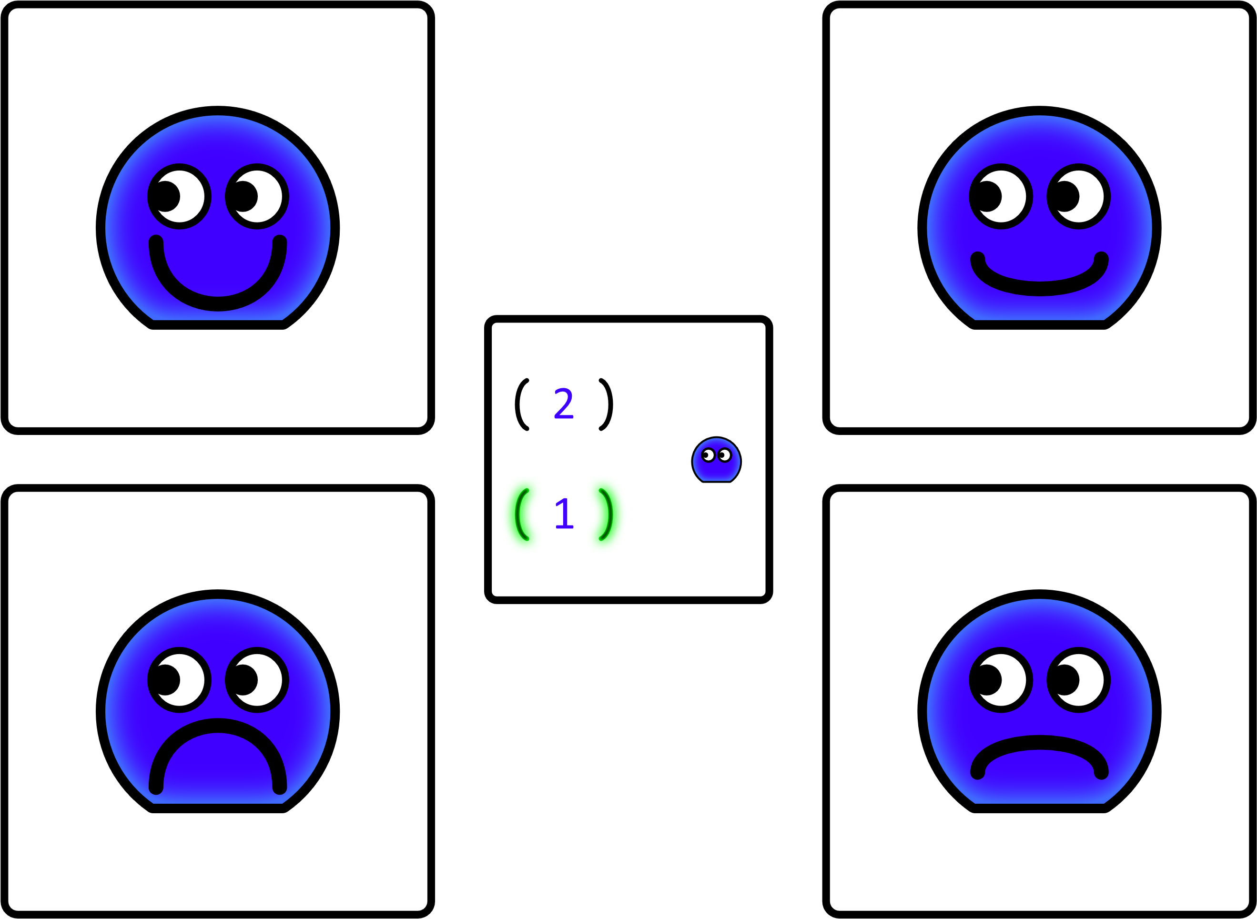
Which template best matches how the avatar will feel as a result of the outcome in the target square?

Slide 26
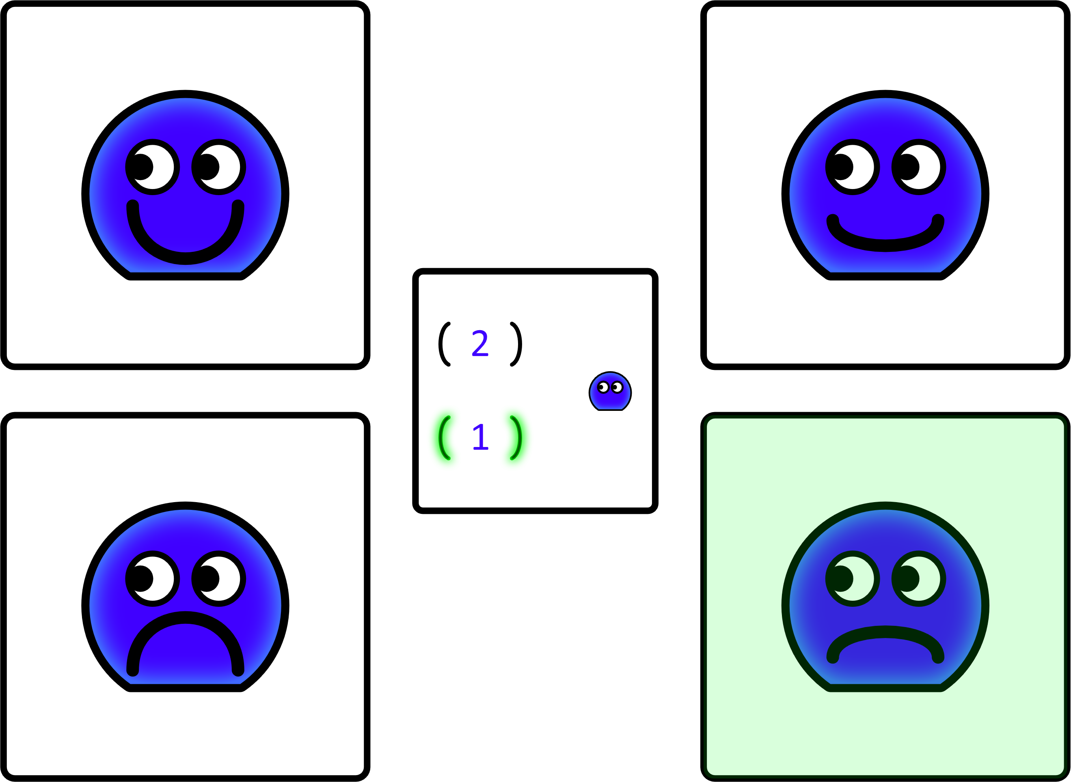
Which template best matches how the avatar will feel as a result of the outcome in the target square?

Slide 27
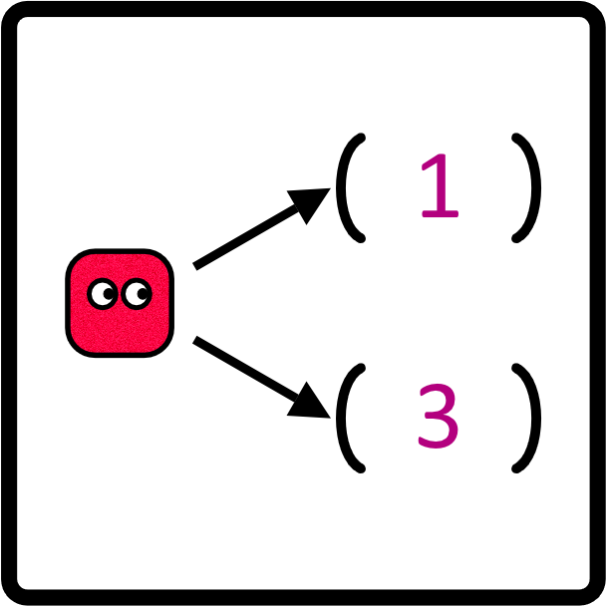
Press the space bar to see the avatar choose.

Slide 28
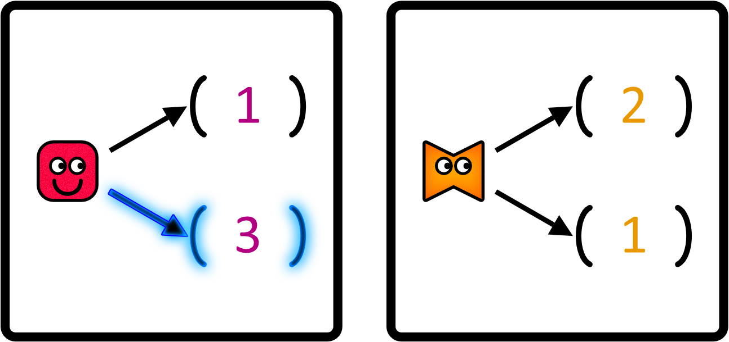
Press the space bar to see the avatar choose.

Slide 29
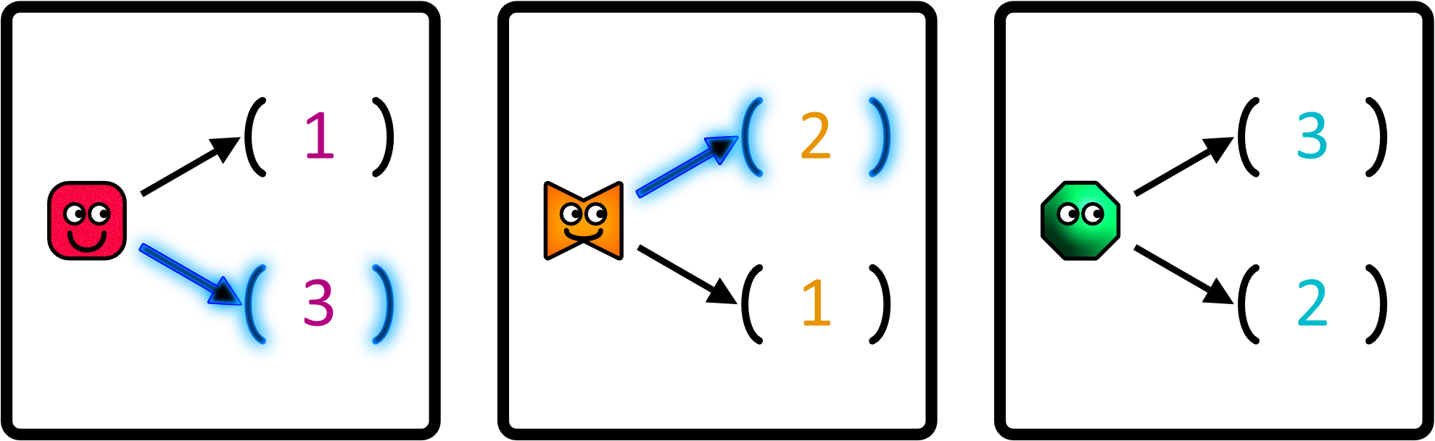
Press the space bar to see the avatar choose.

Slide 30
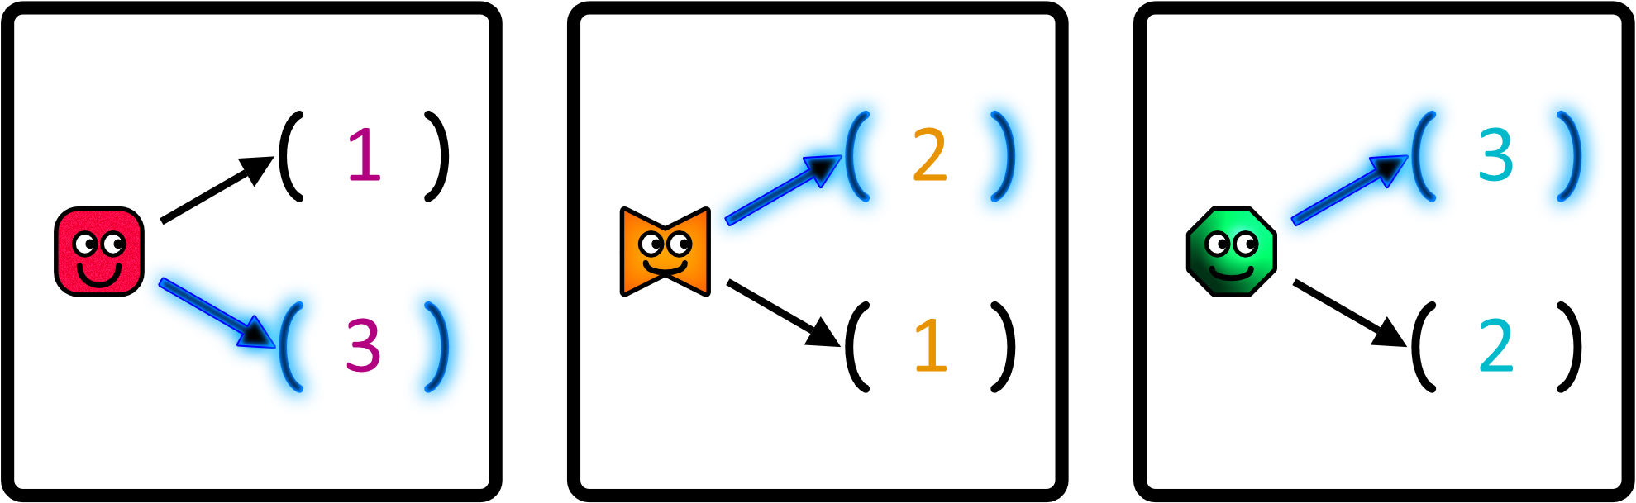
Press the space bar to see the avatar choose.

Slide 31
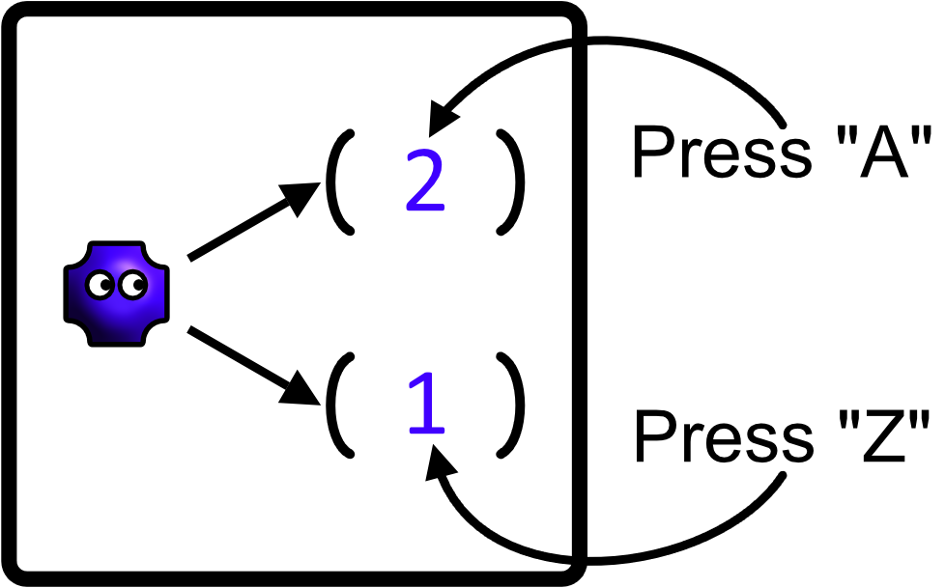
Predict the avatar’s decision by pressing the “A” key or the “Z” key depending on which alternative you expect them to choose.

Slide 32
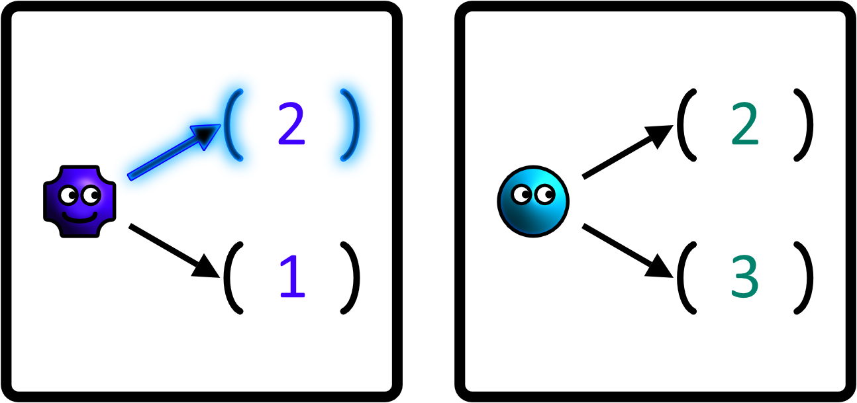
Predict the avatar’s decision by pressing the “A” key or the “Z” key depending on which alternative you expect them to choose.

Slide 33
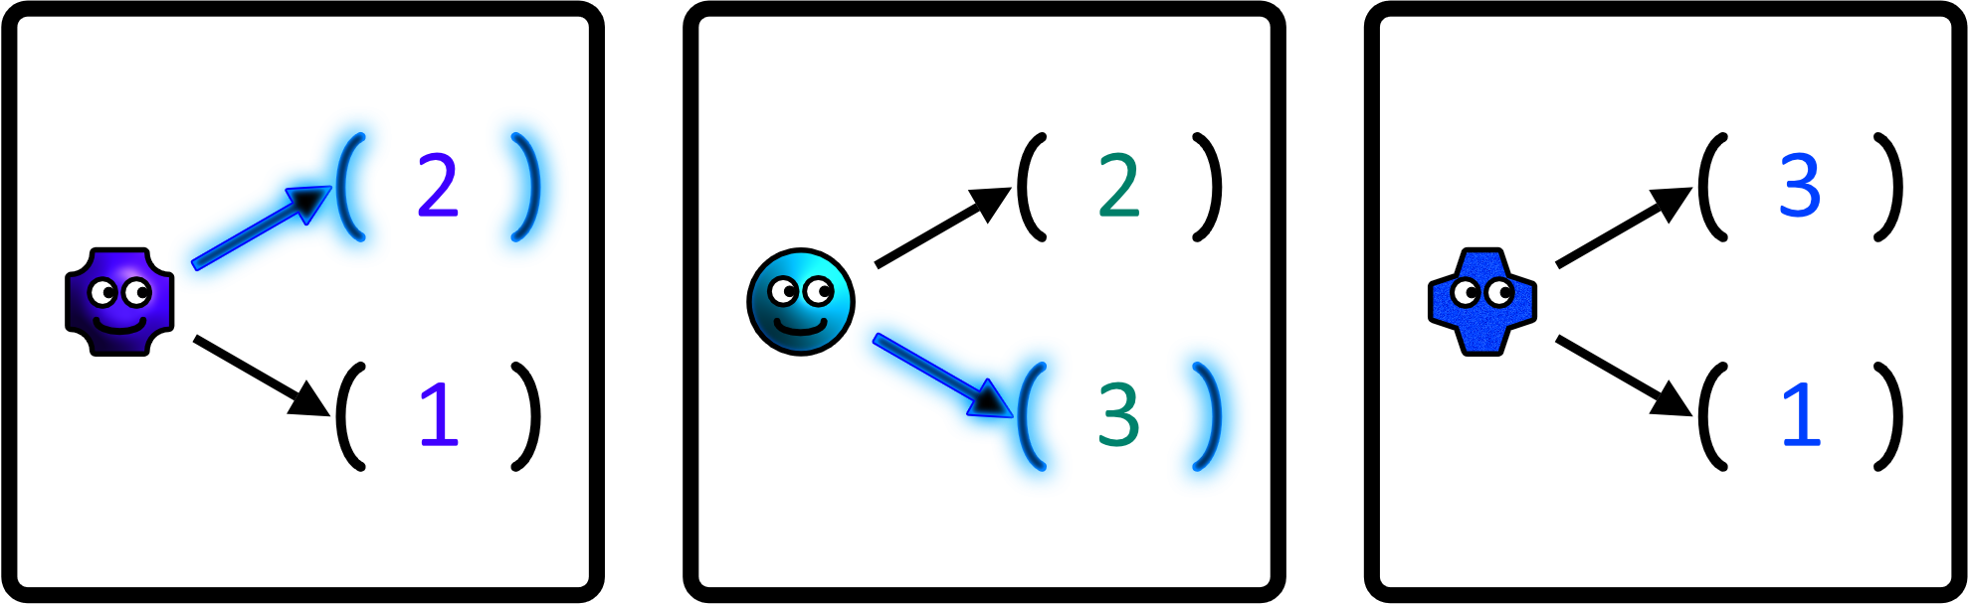
Predict the avatar’s decision by pressing the “A” key or the “Z” key depending on which alternative you expect them to choose.

Slide 34
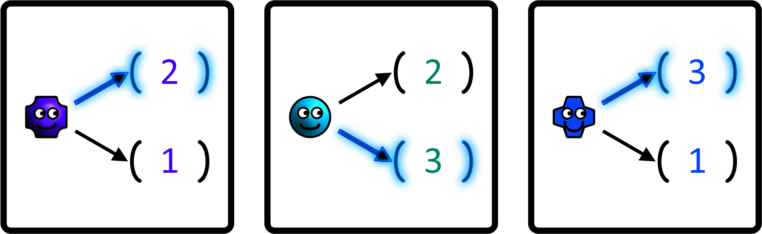
Predict the avatar’s decision by pressing the “A” key or the “Z” key depending on which alternative you expect them to choose.

Slide 35
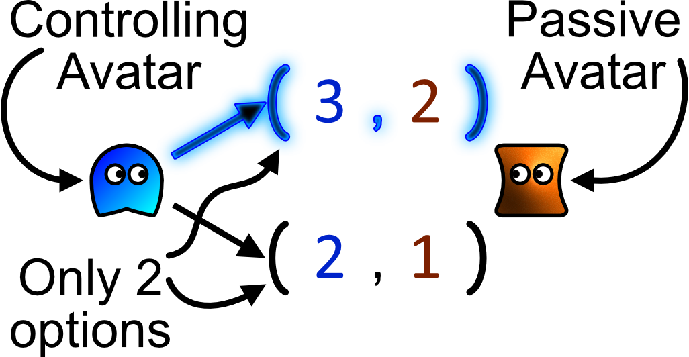
Every choice is between only two options. Once made, decisions cannot be taken back. Choices are made by only one person, while the other passively observes.

Slide 36
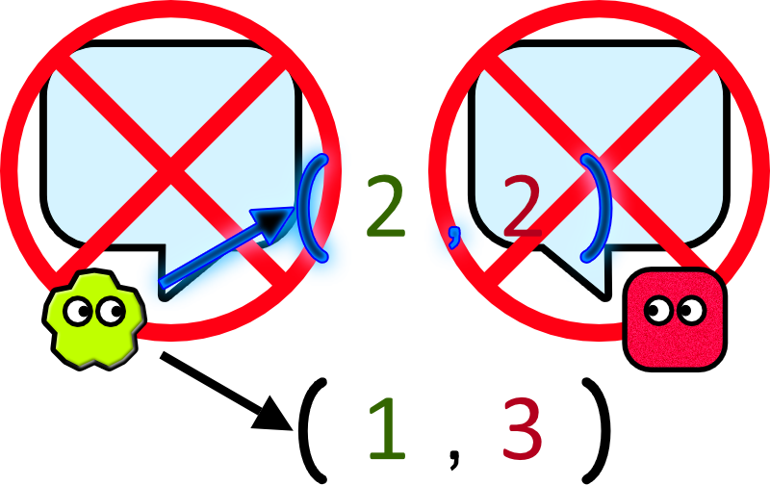
It is not possible for you and the avatar to talk to each other.

Slide 37
The avatars know how choices are made and know that you know how choices are made. They see all the numbers in both alternatives before deciding, meaning that their choices are intentional.

Slide 38
In the following slides, try to predict the correct answer by marking your answer sheet with “T” or “F” before progressing to the next slide.

Slide 39
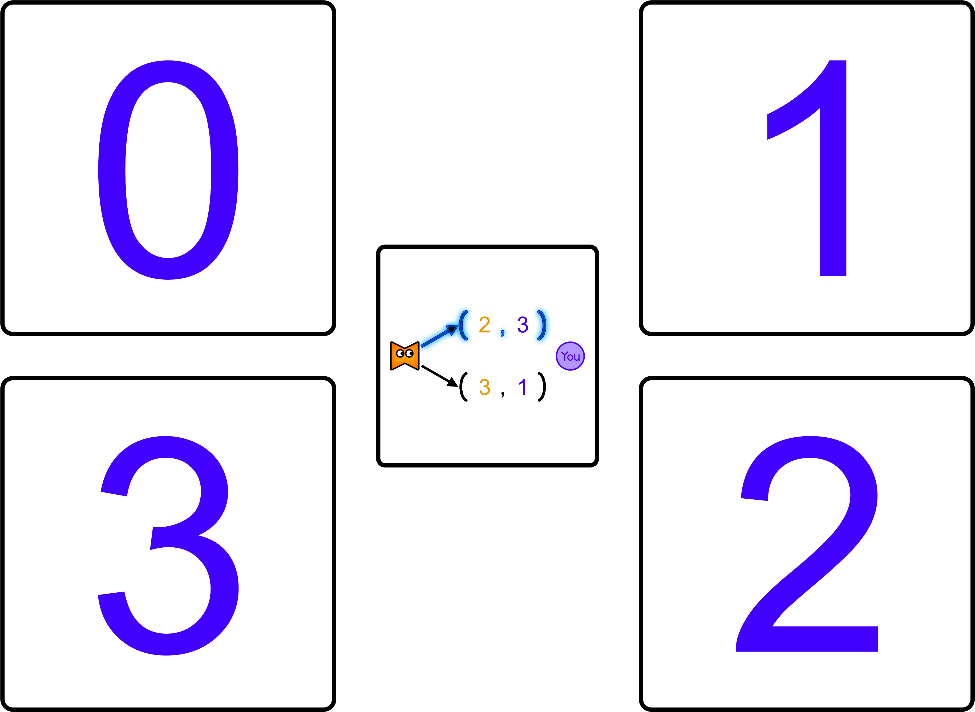
Which number will you receive as a result of this choice?

Slide 40
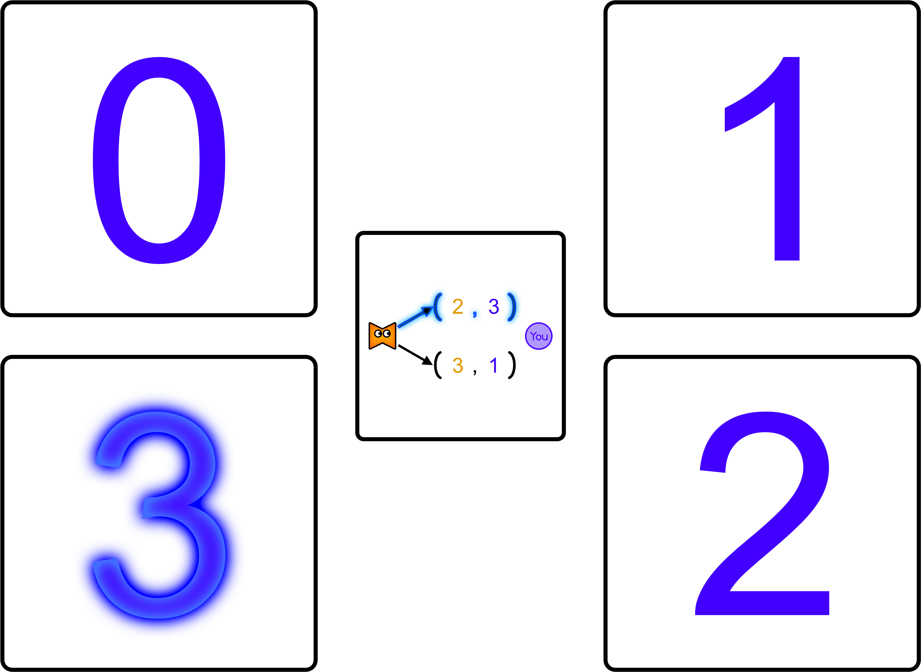
Which number will you receive as a result of this choice?

Slide 41
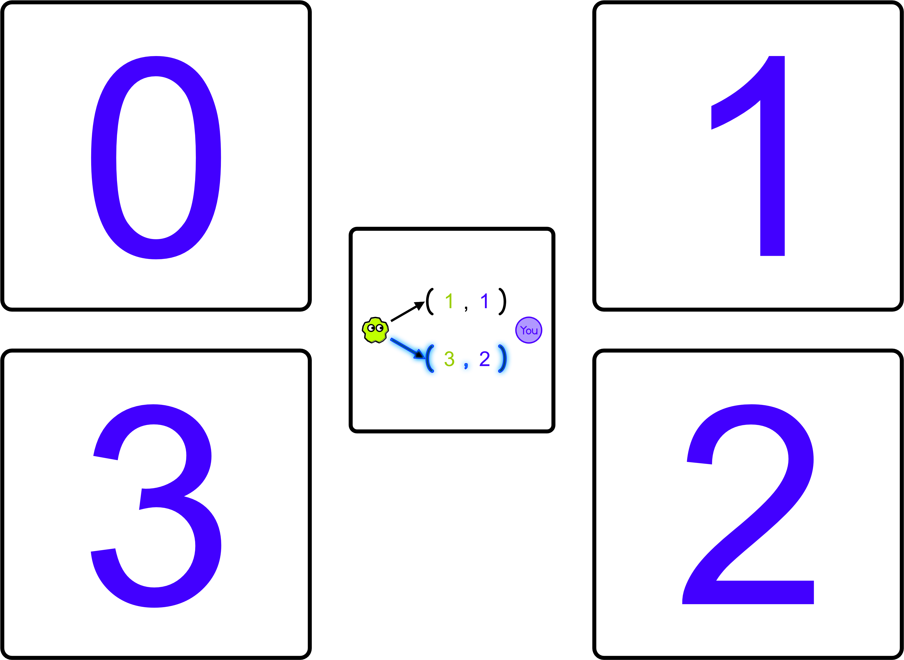
Which number will you receive as a result of this choice?

Slide 42
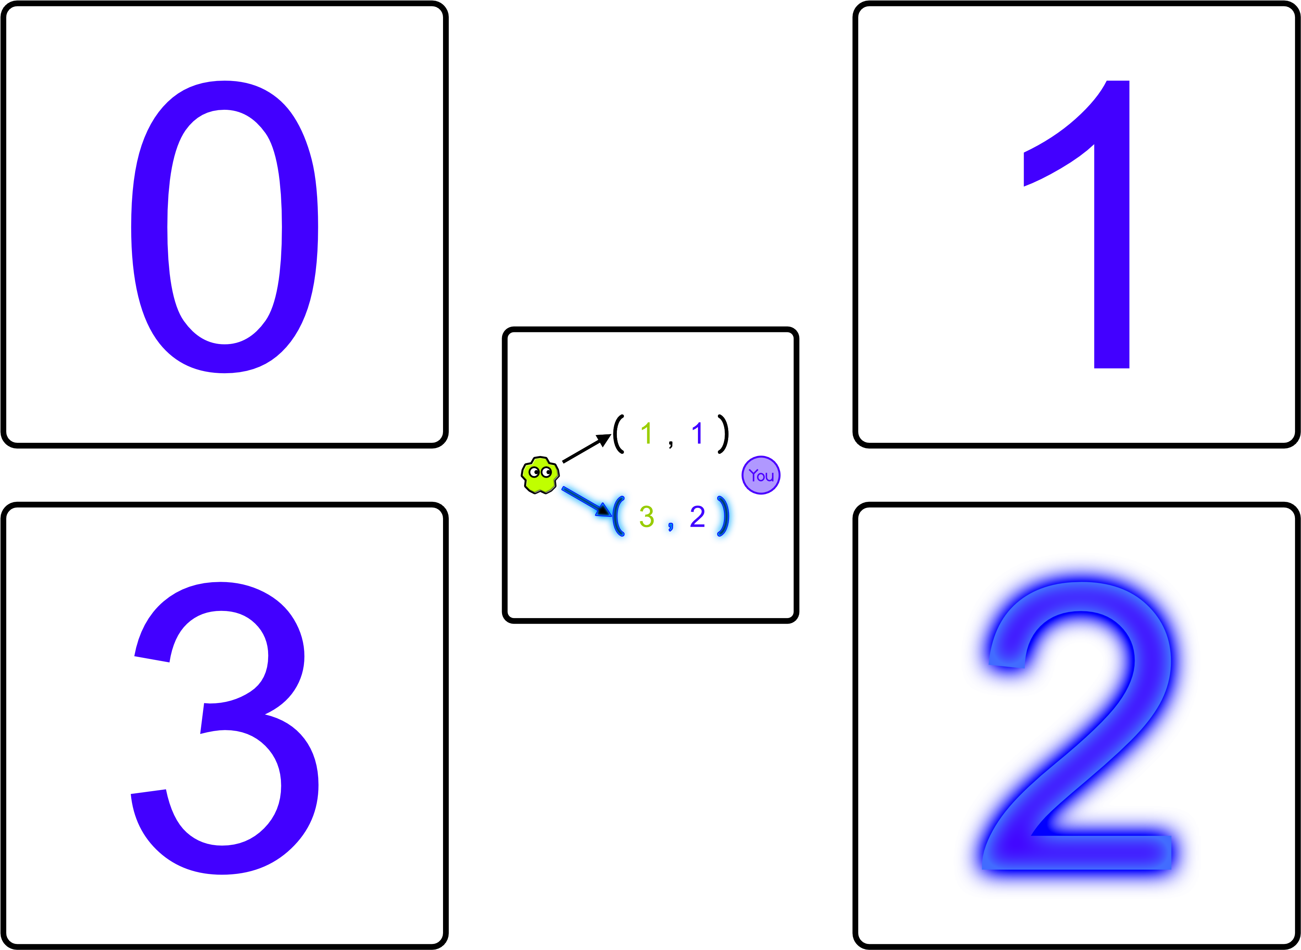
Which number will you receive as a result of this choice?

Slide 43
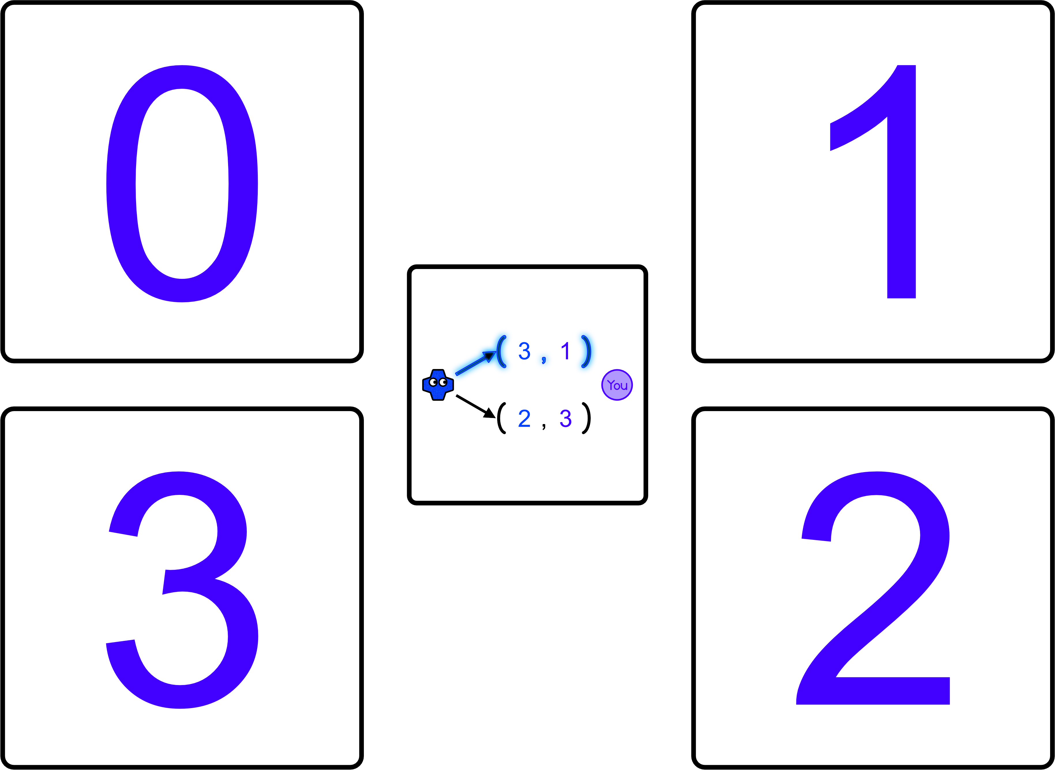
Which number will you receive as a result of this choice?

Slide 44
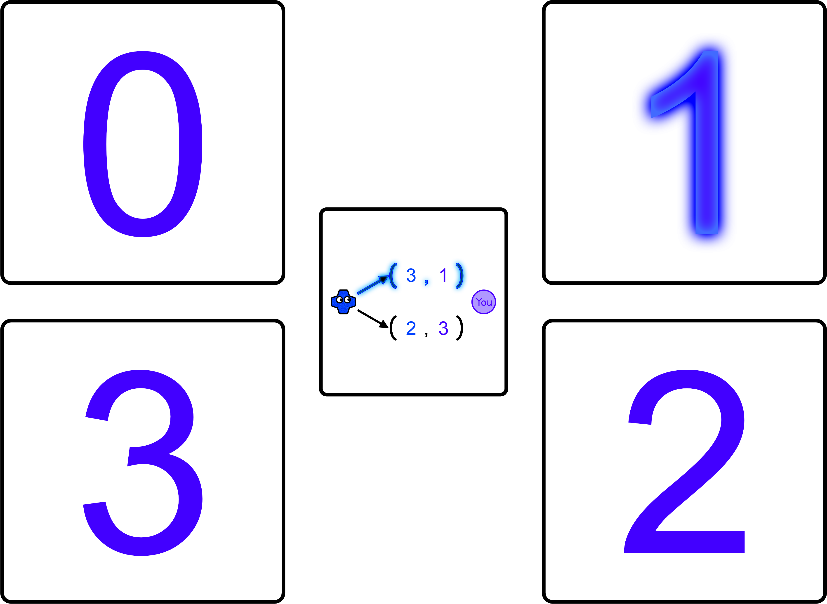
Which number will you receive as a result of this choice?

Slide 45
You are about to be asked a series of true or false questions. Please do you best to answer correctly. You should see a page numbered 1 to 15 beside you. Mark each number with T for true and F for false before you progress to the next slide. If you don’t understand after seeing the answer, please ask the experimenter to explain.

Slide 46
Question 1) True or False: You can talk to the avatars.

Slide 47
Question 1) True or False: You can talk to the avatars. False. It is not possible for you and the avatar to talk to each other.

Slide 48
Question 2) True or False: The numbers that you and the avatar receive can be switched, divided, or shared.

Slide 49
Question 2) True or False: The numbers that you and the avatar receive can be switched, divided, or shared. False. The outcome of every choice is final.

Slide 50
Question 3) True or False: Every choice is between only two options.

Slide 51
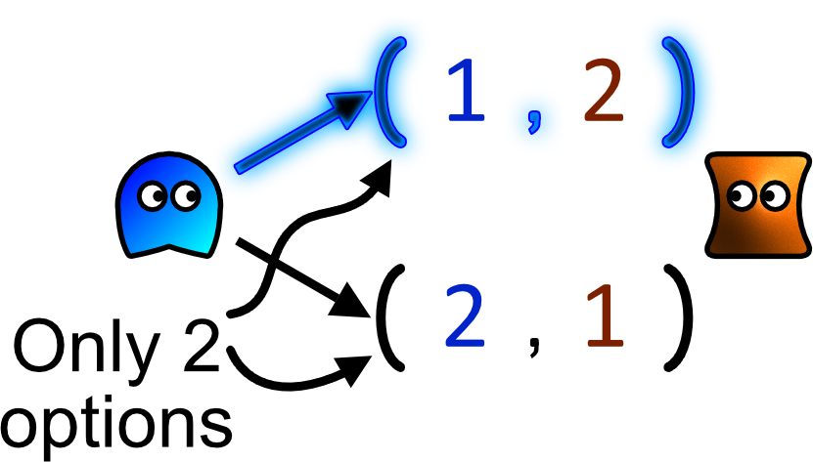
Question 3) True or False: Every choice is between only two options. True.

Slide 52
Question 4) True or False: Some of the avatars already know who you are.

Slide 53
Question 4) True or False: Some of the avatars already know who you are. False. Act towards each avatar as if you are encountering a real person for the first time.

Slide 54
Question 5) True or False: These avatars expect to meet you many times in the future.

Slide 55
Question 5) True or False: These avatars expect to encounter you many times in the future. True. Once the screen displays a new avatar you will never see the last avatar again in this experiment. Nevertheless, you should still act towards the avatar as if you both expect to encounter each other repeatedly in the future.

Slide 56
Question 6) True or False: On a single screen, the avatar who made the prior choice is always the same as the avatar making the current choice.

Slide 57
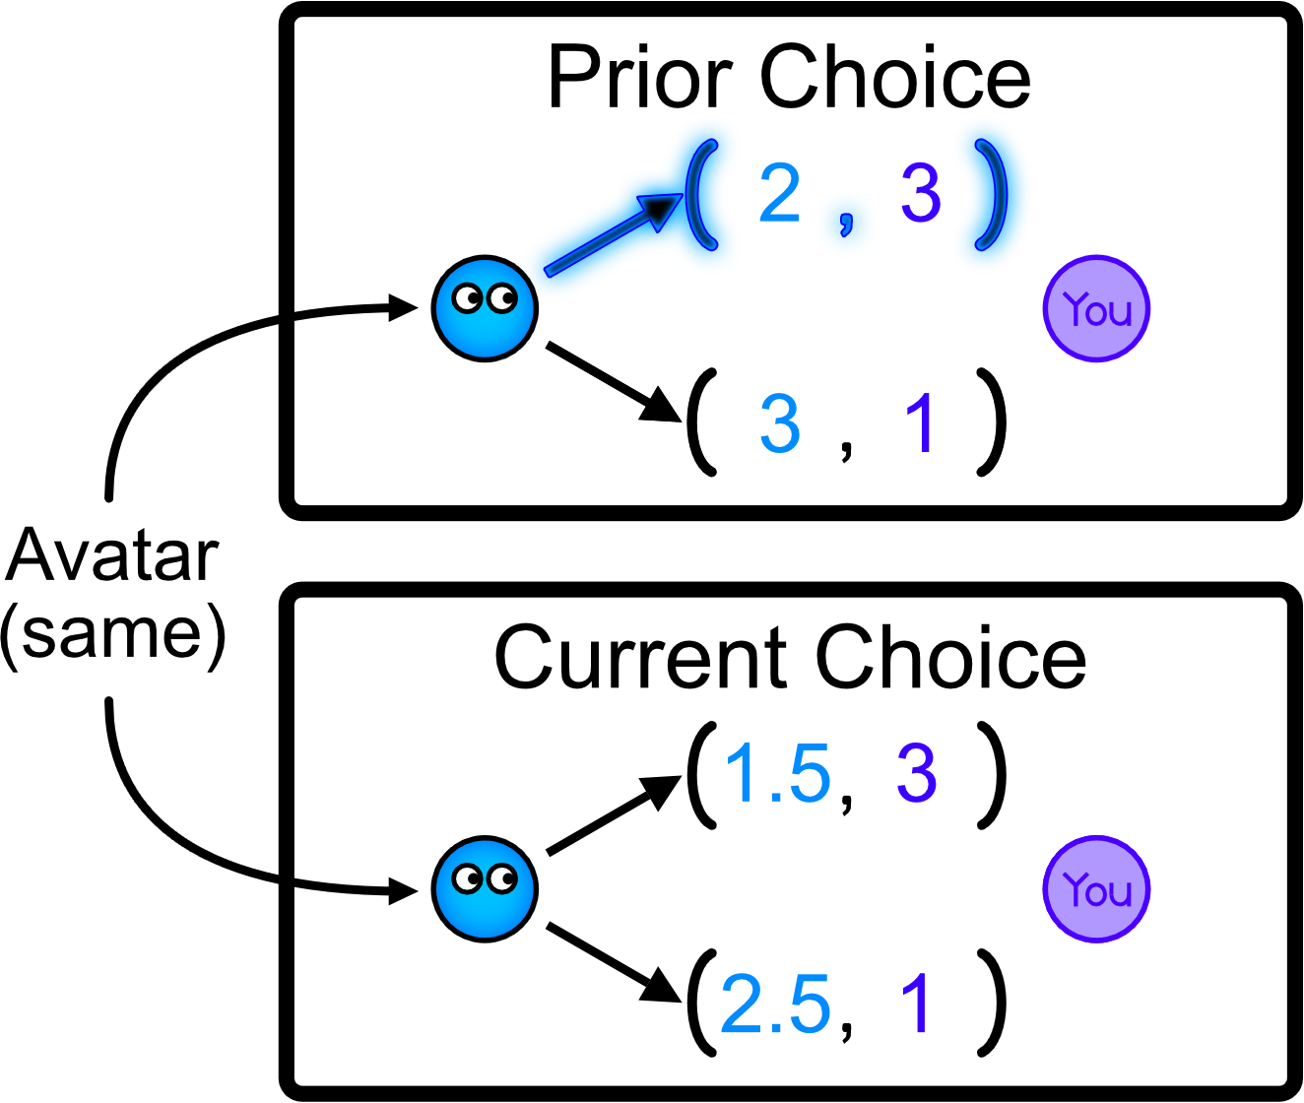
Question 6) True or False: On a single screen, the avatar who made the prior choice is always the same as the avatar making the current choice. True.

Slide 58
Question 7) True or False: The avatar’s preferences for numbers depend on a number they have prior to making the choice.

Slide 59
Question 7) True or False: The avatar’s preferences for numbers depend on a number they have prior to making the choice. False. Avatar’s preferences depend only on a comparison between both alternatives that they are deciding between at the time.

Slide 60
Question 8) True or False: The avatar’s emotion results from a comparison between the number in the outcome and the number in the alternative.

Slide 61
Question 8) True or False: The avatar’s emotion results from a comparison between the number in the outcome and the number in the alternative. True. Nevertheless, their emotions will be hidden throughout the rest of the experiment.

Slide 62
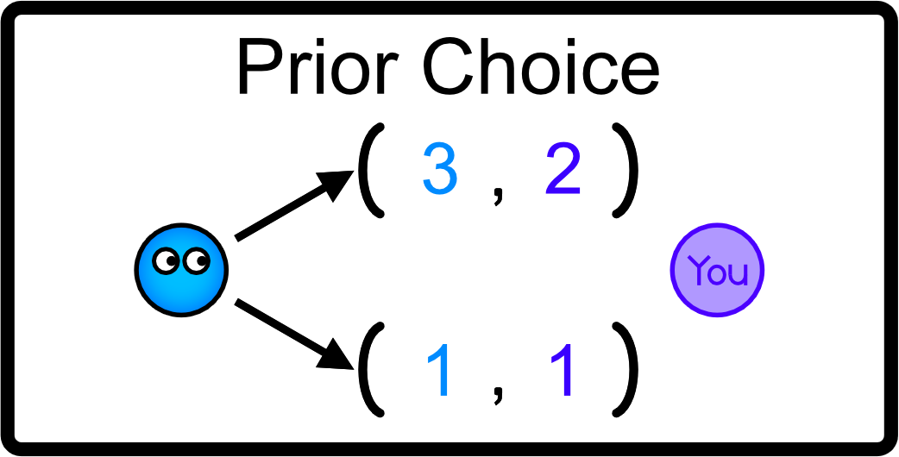
Every time you encounter a new avatar, press the space bar to reveal their choice.

Slide 63
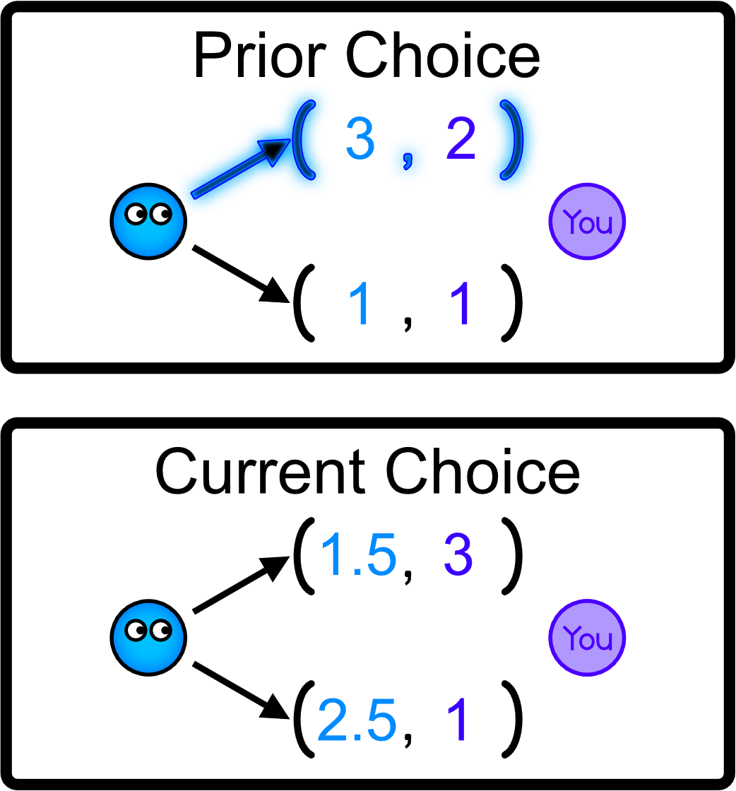

Slide 64
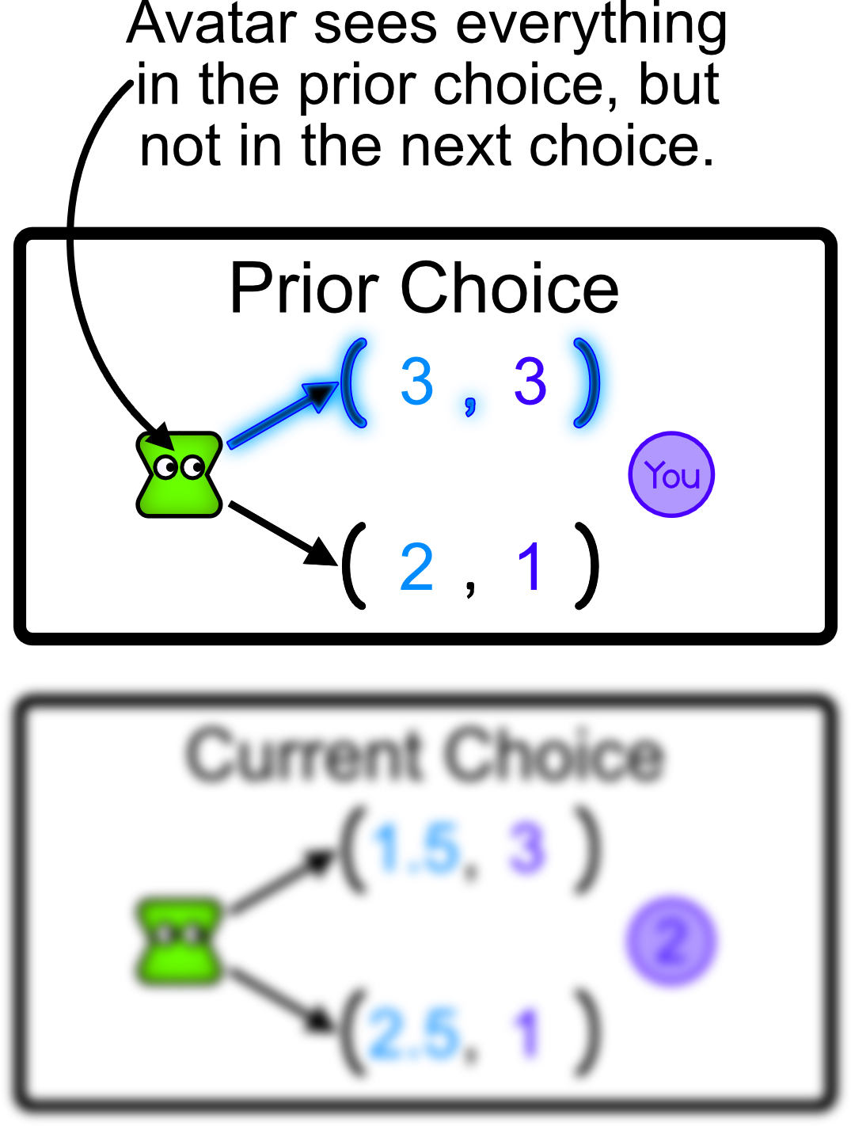
This square is labeled the “Prior Choice” because it is made immediately before the “Current Choice” appears. Avatars make their prior choice before they know the numbers that will appear in the current choice.

Slide 65
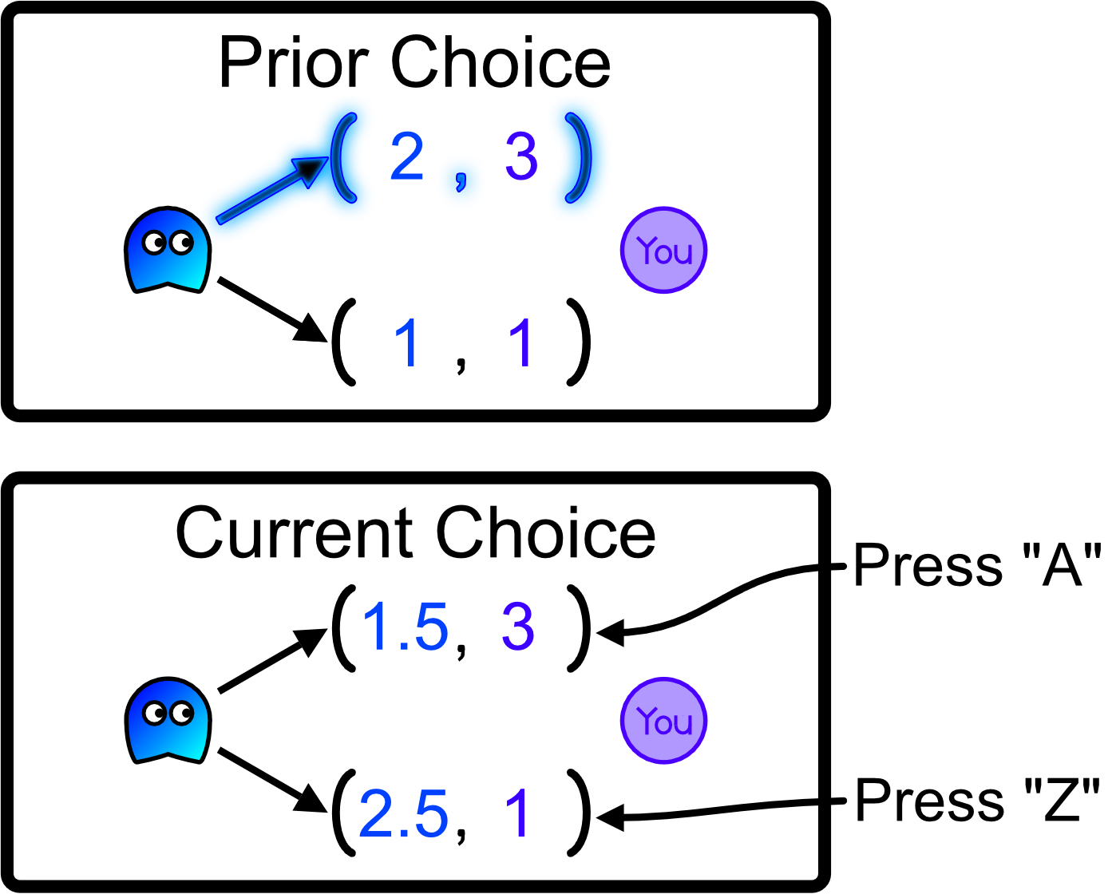
After observing the prior choice, predict what the avatar would choose in the current choice. Avatars can not see predictions and predictions will not influence the outcomes of the current choice.

Slide 66
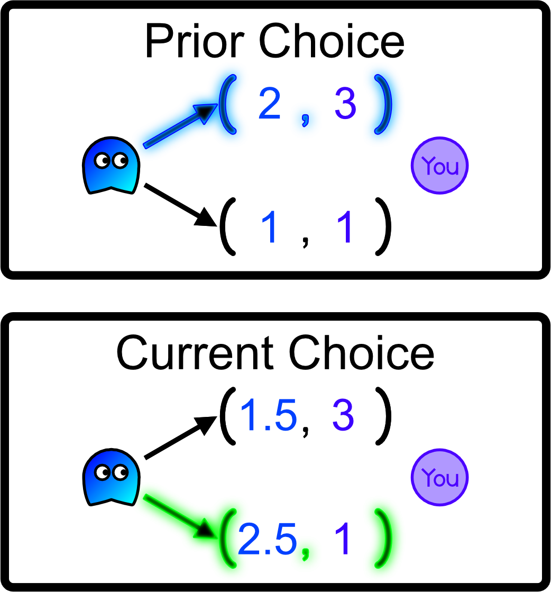
After observing the prior choice, predict what the avatar would choose in the current choice. Avatars can not see predictions and predictions will not influence the outcomes of the current choice.

Slide 67
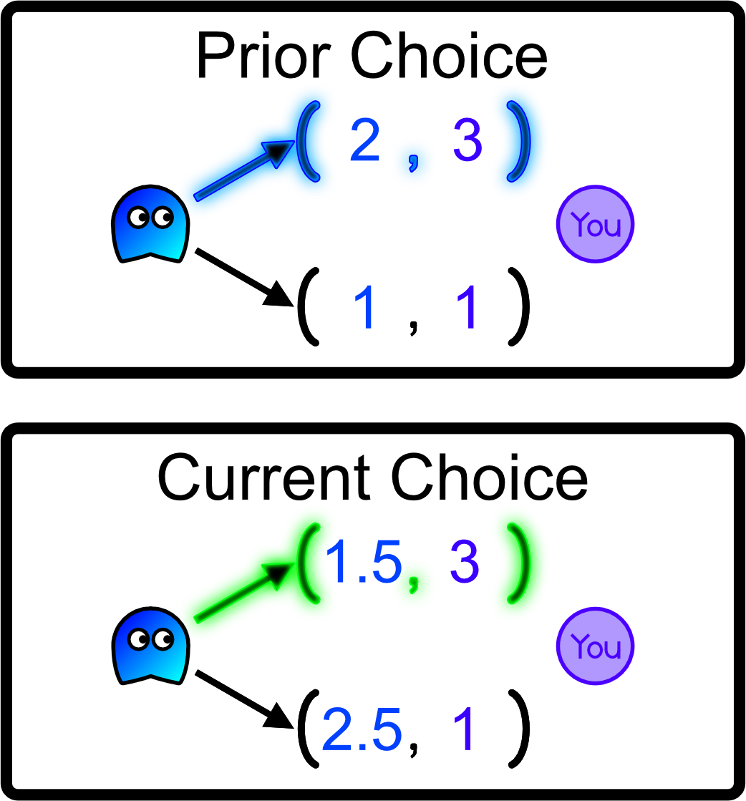
After observing the prior choice, predict what the avatar would choose in the current choice. Avatars can not see predictions and predictions will not influence the outcomes of the current choice.

Slide 68
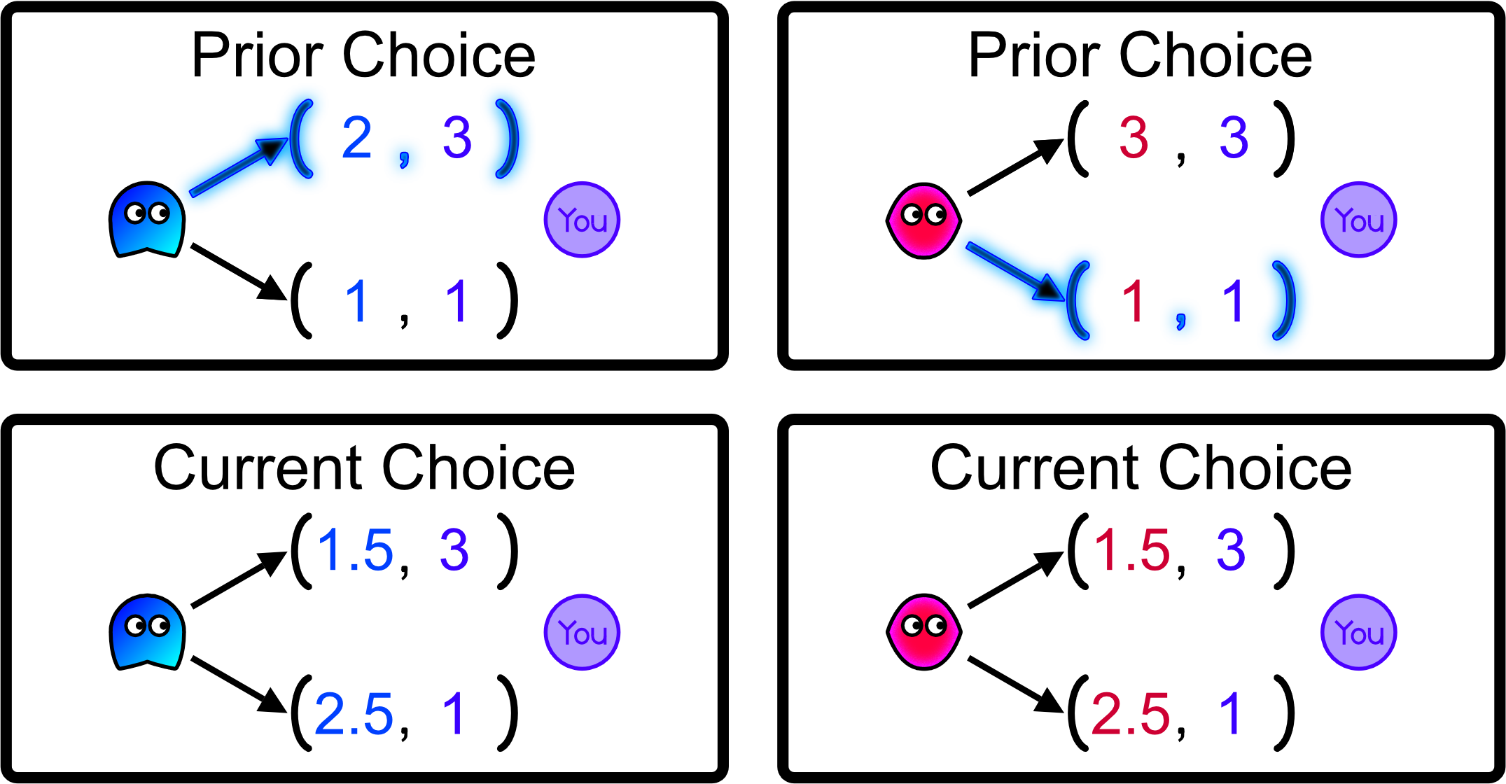
After observing the prior choice, predict what the avatar would choose in the current choice. Avatars can not see predictions and predictions will not influence the outcomes of the current choice.

Slide 69
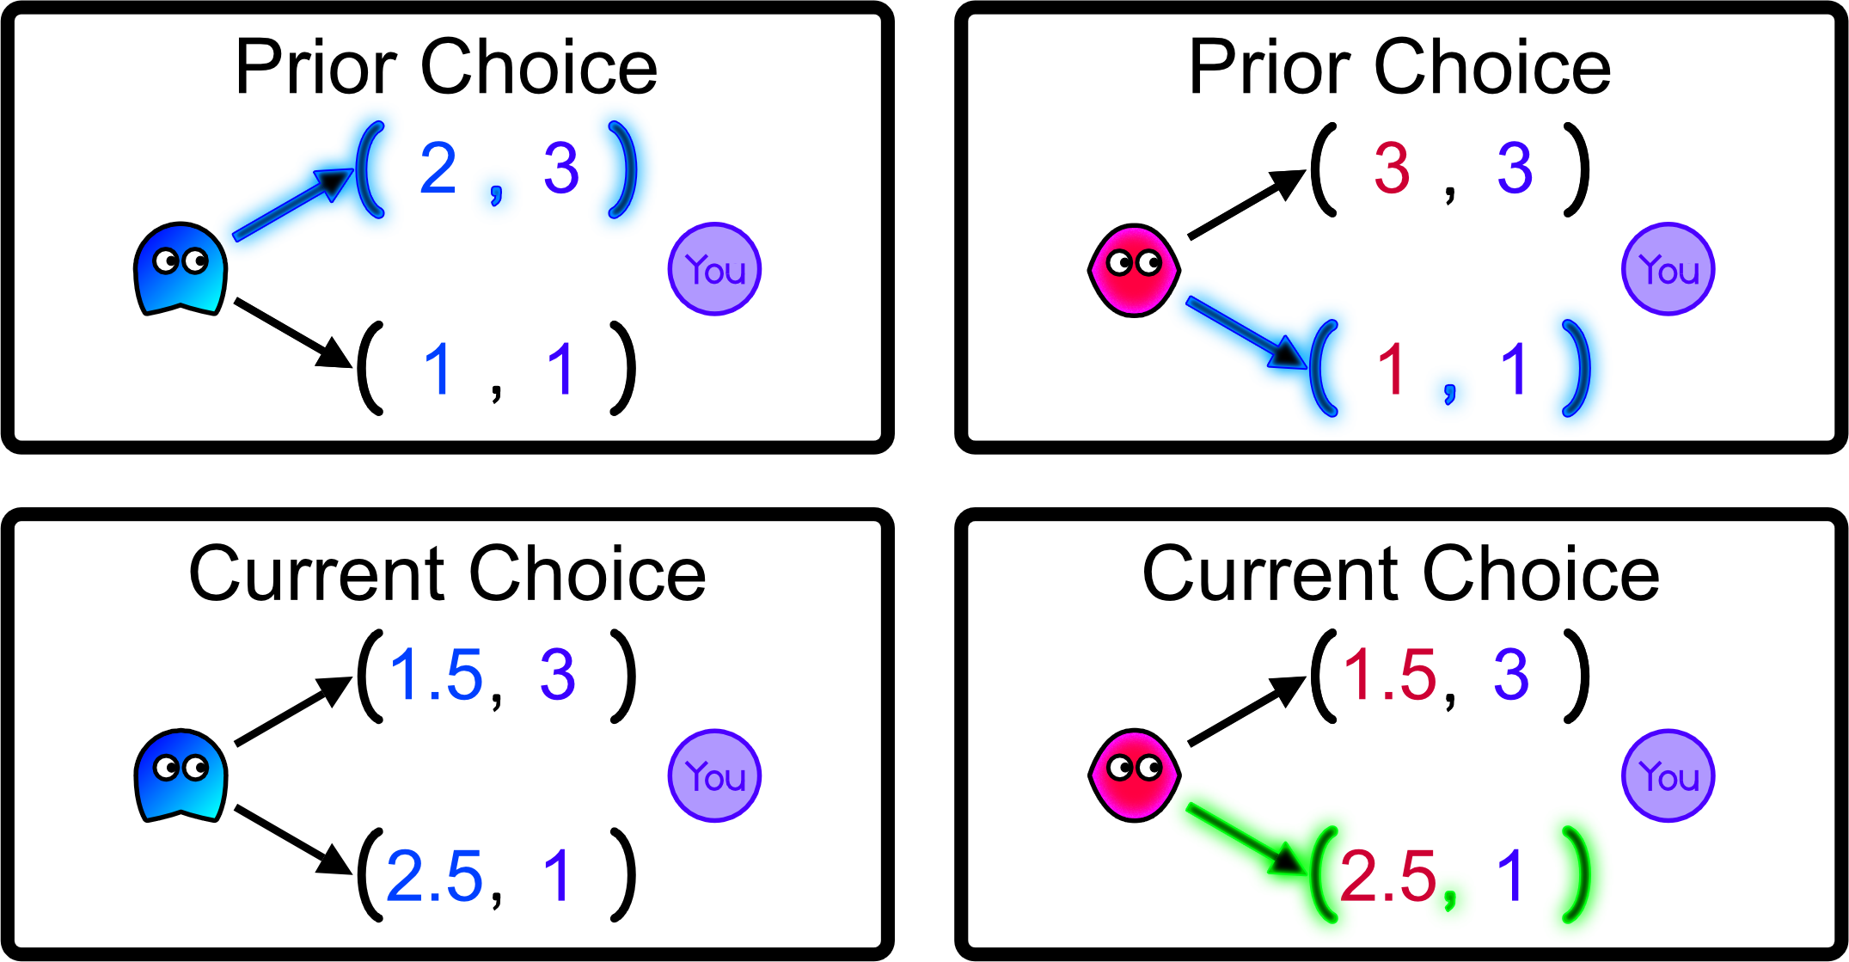
After observing the prior choice, predict what the avatar would choose in the current choice. Avatars can not see predictions and predictions will not influence the outcomes of the current choice.

Slide 70
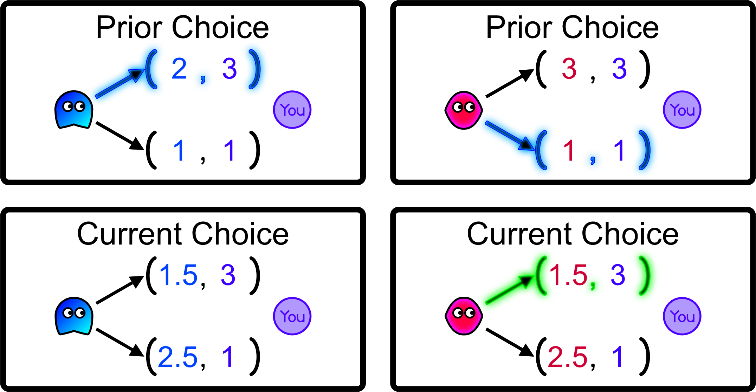
After observing the prior choice, predict what the avatar would choose in the current choice. Avatars can not see predictions and predictions will not influence the outcomes of the current choice.

Slide 71

After observing the prior choice, predict what the avatar would choose in the current choice. Avatars can not see predictions and predictions will not influence the outcomes of the current choice.

Slide 72

After observing the prior choice, predict what the avatar would choose in the current choice. Avatars can not see predictions and predictions will not influence the outcomes of the current choice.

Slide 73

After observing the prior choice, predict what the avatar would choose in the current choice. Avatars can not see predictions and predictions will not influence the outcomes of the current choice.

Slide 74
You will not be able to see the avatars’ current choices.

Slide 75
As you are about to read, the avatar will only choose in the “Current Choice” if you voluntarily give them control. Nevertheless, predict what they would choose if you were to give them control.

Slide 76

After making this prediction, you must choose to press the right or left arrow key. If you press “K”, then you will receive the number within the purple circle and the avatar cannot choose. However, if you press “J”, then the avatar will choose, meaning that they control the outcome.

Slide 77

If you press “K”, then you will receive a number, but the avatar won’t. This is a neutral outcome for the avatar. They are not affected positively or negatively. However, they will see your choice.

Slide 78


The purple circle will flash different colors to give you feedback about your choice.
J = blue K= pink

Slide 79
The blue bar at the top of the screen will extend from left to right as you progress through the 216 avatars. It represents a percentage out of 216.

Slide 80
Question 9) True or False: You will only see the avatar’s current choice if you choose to move.

Slide 81
Question 9) True or False: You will only see the avatar’s current choice if you select “J”. False. Avatar’s only make a current choice if you select “J”, but you will still see the choice they would have made even if you select “K”.

Slide 82
Question 10) True or False: Avatars will see your predictions.

Slide 83
Question 10) True or False: Avatars will see your predictions. False. Your prediction of their current choice is knowable only to you.

Slide 84
Question 11) True or False: Avatar’s will see your choice of “J” or “K”.

Slide 85
Question 11) True or False: Avatar’s will see your choice of “J” or “K”. True.

Slide 86
Question 12) True or False: By choosing “K”, the avatar receives “0”.

Slide 87
Question 12) True or False: By choosing “K”, the avatar receives “0”. False. Choosing “K” causes the avatar to not receive a number, which is a neutral outcome. They are not impacted positively or negatively in any way by this choice.

Slide 88
Question 13) True or False: Some avatars can see the numbers in the current choice before they make their prior choice.

Slide 89
Question 13) True or False: Some avatars can see the numbers in the current choice before they make their prior choice. False. Avatars only choose based the numbers they presently face.

Slide 90
Question 14) True or False: The outcome results from the choices made simultaneously by you and the avatar.

Slide 91

Question 14) True or False: The outcome results from the choices made simultaneously by you and the avatar. False. Outcomes are decided by only one person at a time.

Slide 92
Question 15) True or False: All avatars know that choices are between only two options, choices are final, numbers cannot be shared/divided, verbal communication is impossible, and that you know all these things.

Slide 93
Question 15) True or False: All avatars know that choices are between only two options, choices are final, numbers cannot be shared/divided, verbal communication is impossible, and that you know all these things. True.

Slide 94
End of Tutorial
Please begin Block 1 of the experiment.

